Slide 1
Computational Results for the Tiltwing Test Rig using Overflow
James C. Jensen, Marie F. Denison, and Andrew M. Chuen
17th Overset Grid Symposium– Penn State University, PA – September 21-24, 2026
NASA Ames Research Center
Moffett Field, CA

Slide 2
Outline
Background
Automated Mesh Generation with EPOGS
Computational Methodology
Post-Test CFD Results
  RANS with Rotor Disk Model
  Adaption and URANS with Rotor Disk Model
  DDES with Resolved Blades
Conclusions

Slide 3
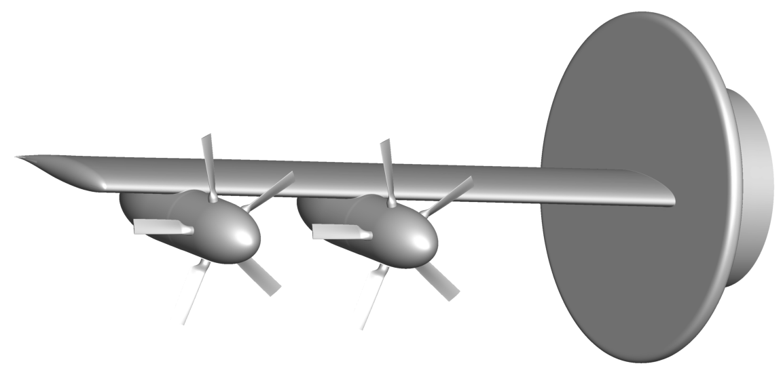
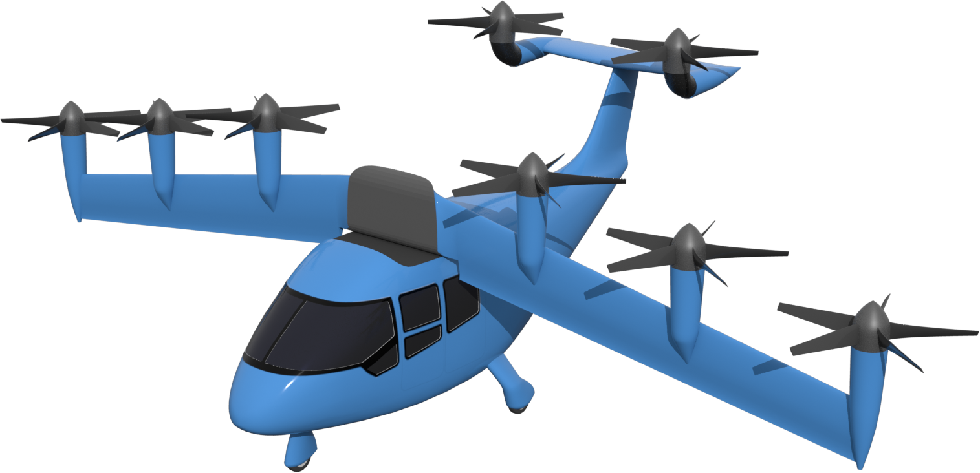
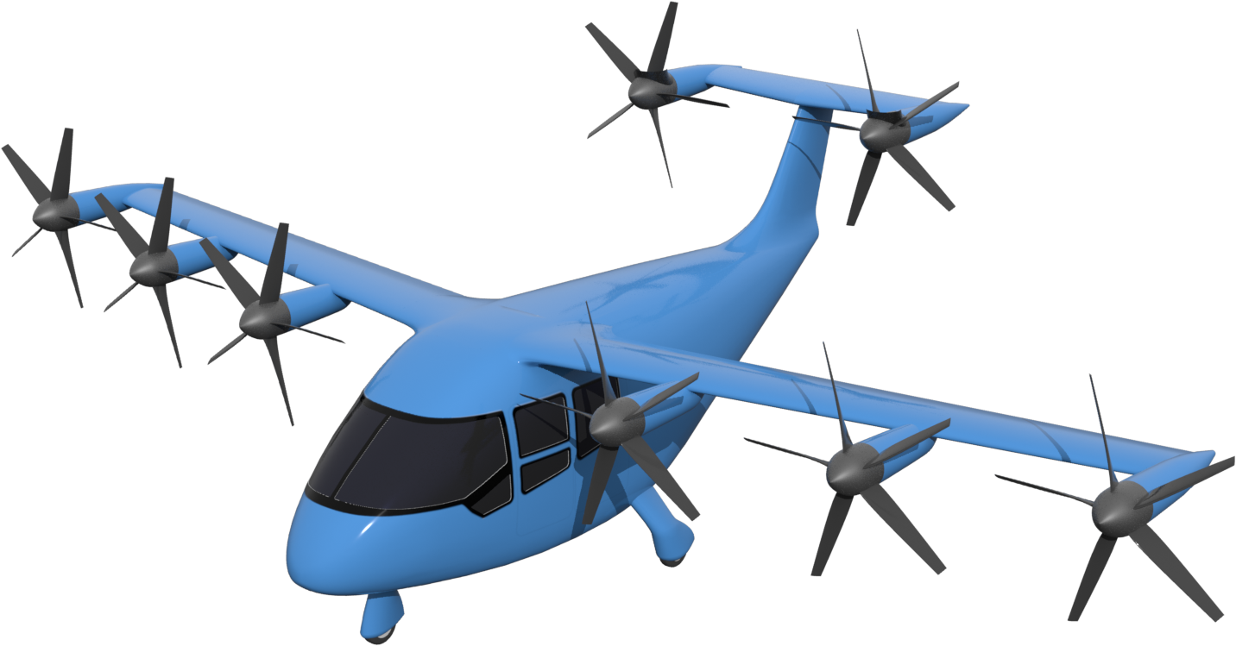
Background
Tiltwing Concept Vehicle
  Designed under NASA’s Revolutionary Vertical Lift Technologies project
Tiltwing Test Rig
  Scale model of half the span of the wing
  Experiment conducted at NASA Langley’s 14- by 22-foot Subsonic Tunnel from 05/25 - 06/25
  Experiment only used 2 nacelles
  2ft diameter proprotors
Tiltwing Test Rig Computational Geometry
Tiltwing Concept Vehicle in Hover
Tiltwing Concept Vehicle in Cruise

Slide 4
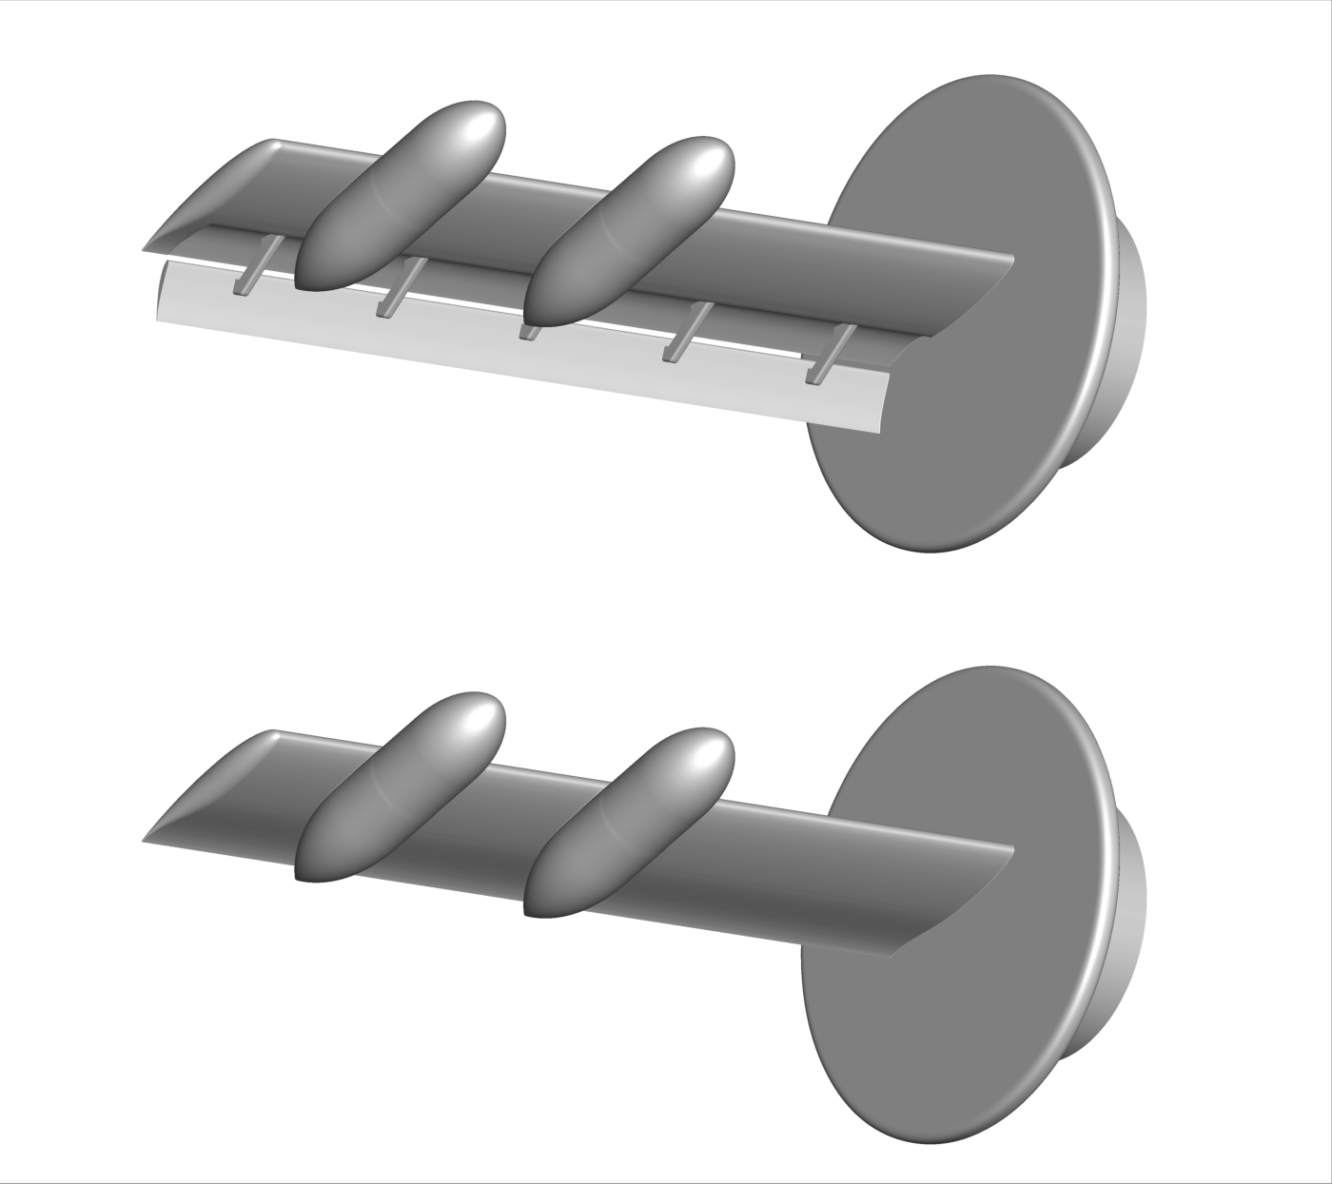
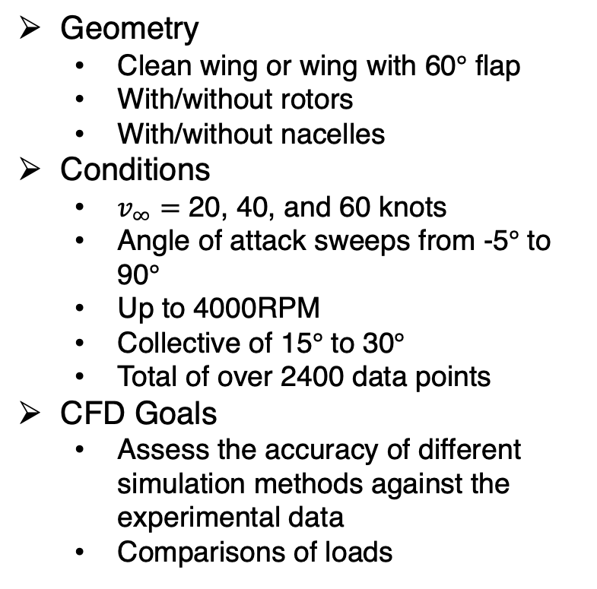
Wind Tunnel Test Overview
Geometry
  Clean wing or wing with 60$°$ flap
  With/without rotors
  With/without nacelles
Conditions
  $v_{∞}=$ 20, 40, and 60 knots
  Angle of attack sweeps from -5$°$ to 90$°$
  Up to 4000RPM
  Collective of 15$°$ to 30$°$
  Total of over 2400 data points
CFD Goals
  Assess the accuracy of different simulation methods against the experimental data
  Comparisons of loads
Clean Wing
Wing With 60$°$ Flaps

Slide 5
Outline
Background
Automated Mesh Generation with EPOGS
Computational Methodology
Post-Test CFD Results
  RANS with Rotor Disk Model
  Adaption and URANS with Rotor Disk Model
  DDES with Resolved Blades
Conclusions

Slide 6
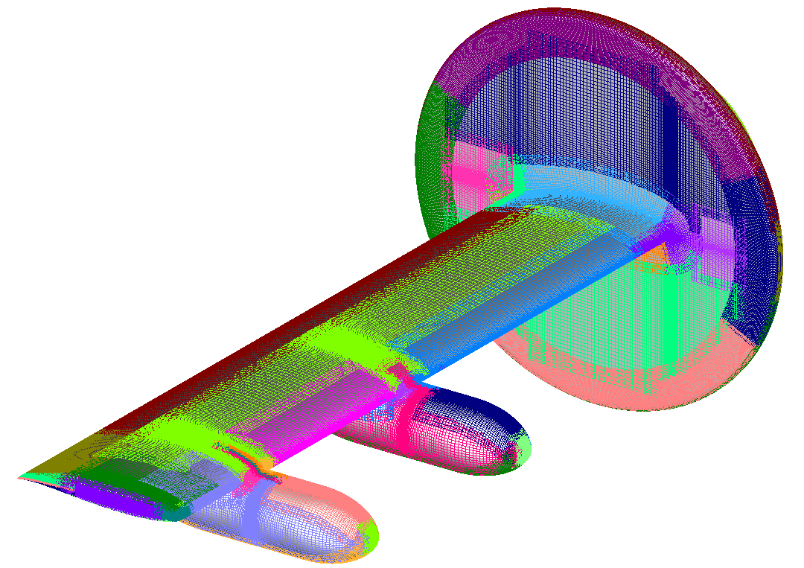
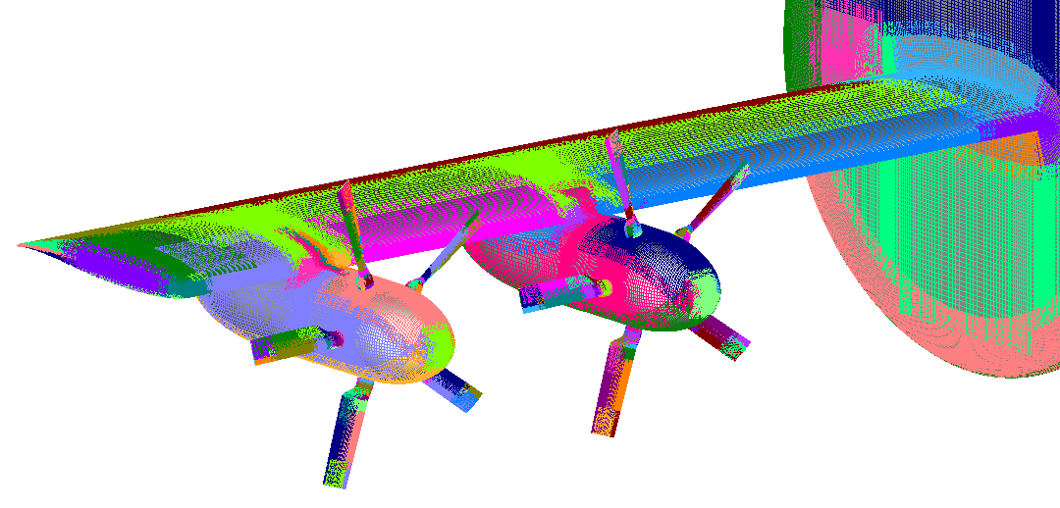
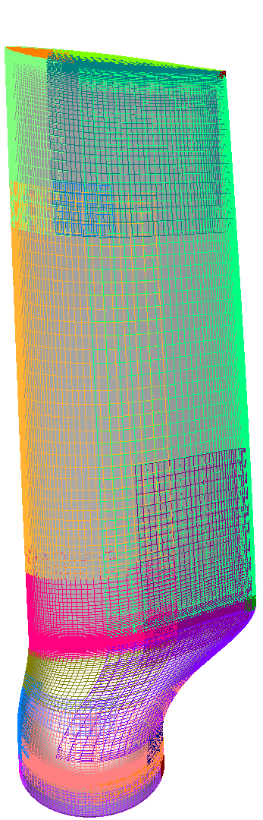
Mesh Generation using EPOGS
How EPOGS works
  Generates automated structured, overset meshes, and connectivity files starting from a BRep solid
  Uses a relatively simple set of global inputs to control the meshes
Generating the TWTR meshes
  Used two bodies: one for the wing, nacelles, and mount, and one for the blade
  Used EPOGS’ ”combine” function to generate the final geometry
  Limited maximum cell size to 10% the local tip chord with a maximum stretching ratio of 1.2
  Actuator zone meshes were manually generated
+
=
See AIAA 2024-4305 for more details on EPOGS
Notes:
In actuality the maximum cell size near the blade tips is about 2.5% of the tip chord

Slide 7
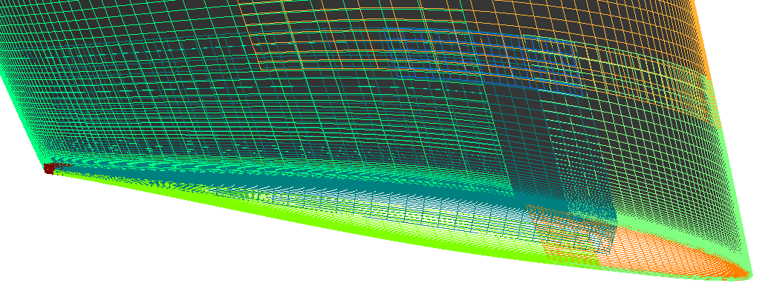
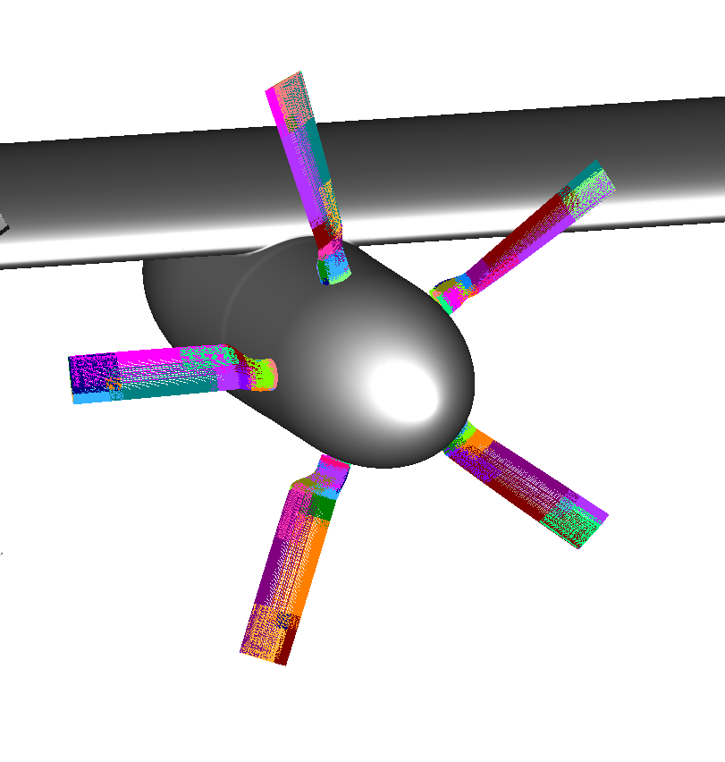
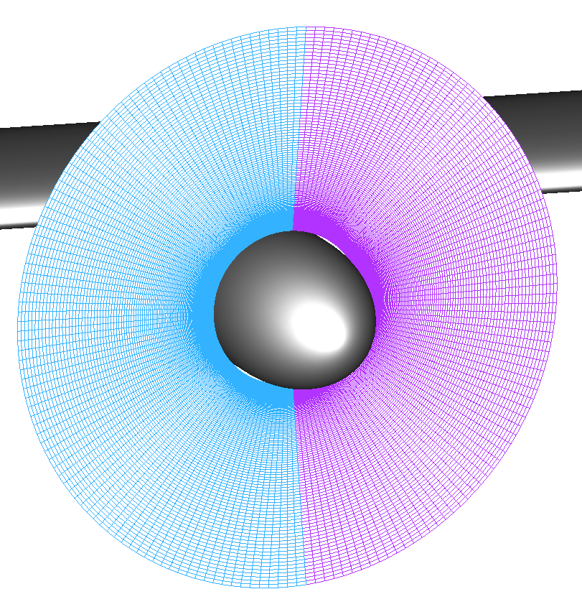
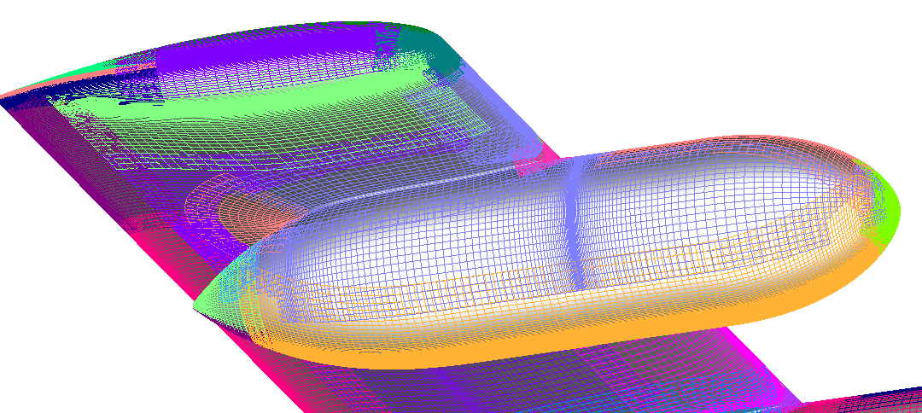
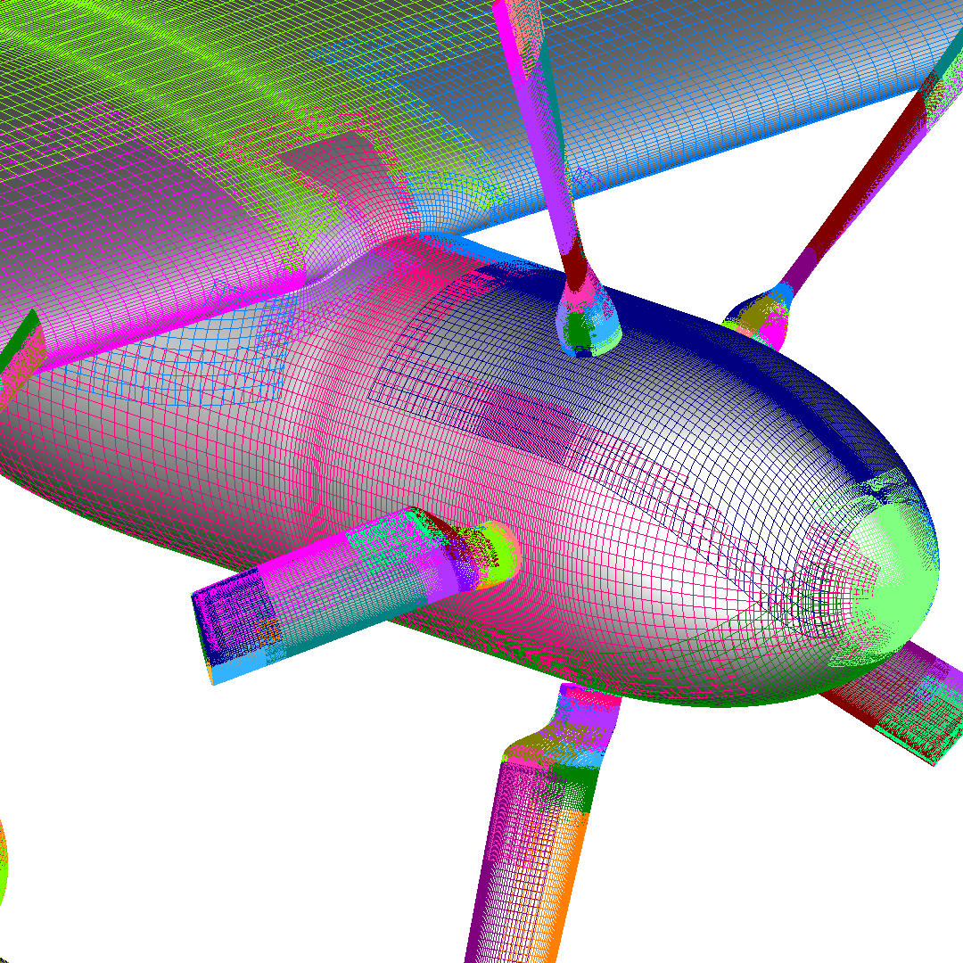
Example Surface Meshes
Wing Tip
Blade Tip
Proprotor Blade Grids
Actuator Disk Grid
 | # of Points (millions) | # of Near-Body Grids | # of Off-Body Grids
Actuator Disk | 66.7 | 86 | 110
Blade Resolved | 121.4 | 350 | 78
Inboard Nacelle and Blades

Slide 8
Outline
Background
Automated Mesh Generation with EPOGS
Computational Methodology
Post-Test CFD Results
  RANS with Rotor Disk Model
  Adaption and URANS with Rotor Disk Model
  DDES with Resolved Blades
Conclusions

Slide 9
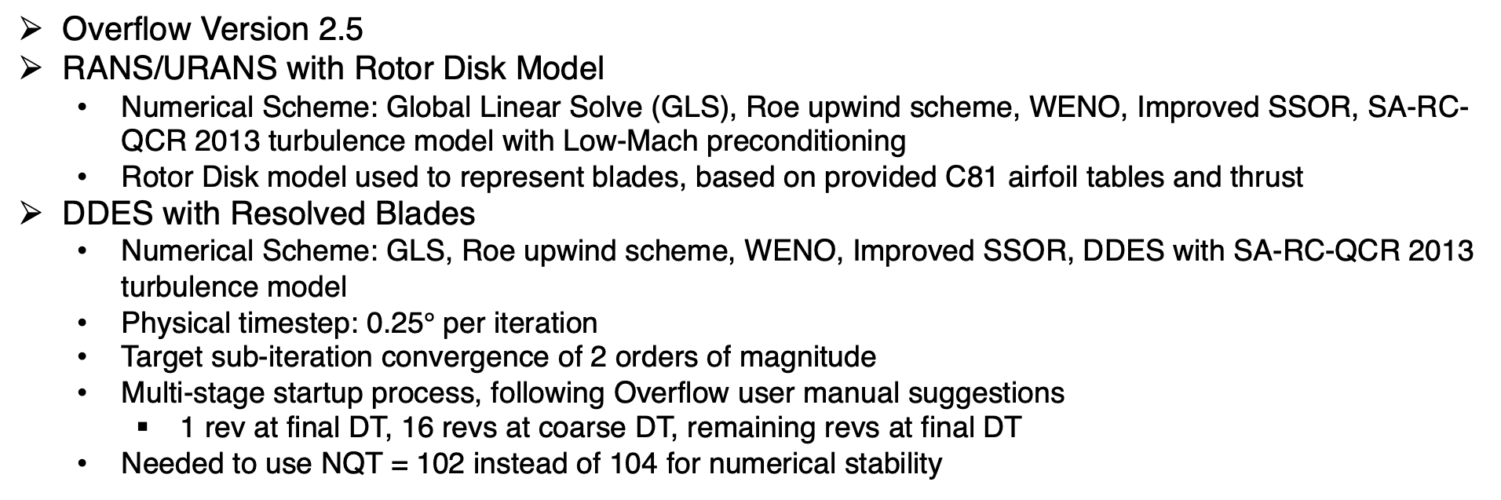
Computational Methods
Overflow Version 2.5
RANS/URANS with Rotor Disk Model
  Numerical Scheme: Global Linear Solve (GLS), Roe upwind scheme, WENO, Improved SSOR, SA-RC-QCR 2013 turbulence model with Low-Mach preconditioning
  Rotor Disk model used to represent blades, based on provided C81 airfoil tables and thrust
DDES with Resolved Blades
  Numerical Scheme: GLS, Roe upwind scheme, WENO, Improved SSOR, DDES with SA-RC-QCR 2013 turbulence model
  Physical timestep: 0.25$°$ per iteration
  Target sub-iteration convergence of 2 orders of magnitude
  Multi-stage startup process, following Overflow user manual suggestions
    1 rev at final DT, 16 revs at coarse DT, remaining revs at final DT
  Needed to use NQT = 102 instead of 104 for numerical stability

Slide 10
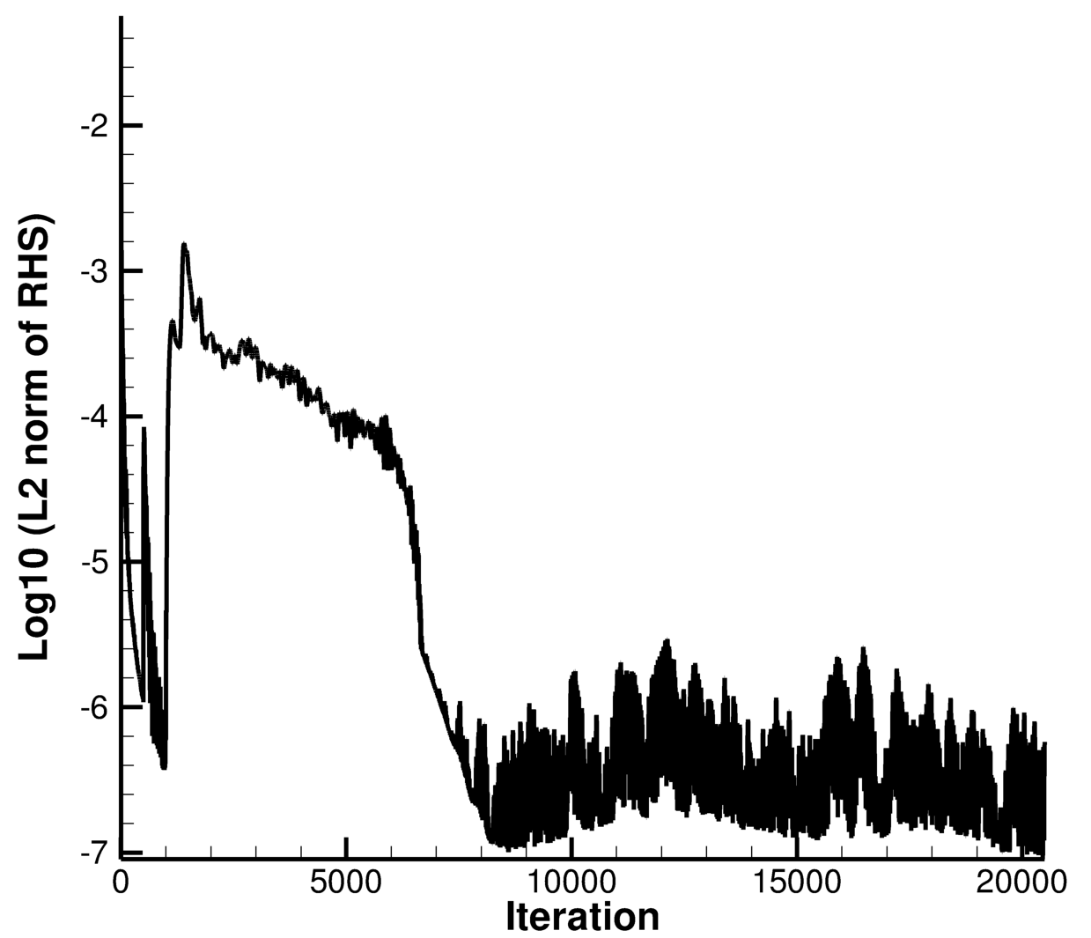
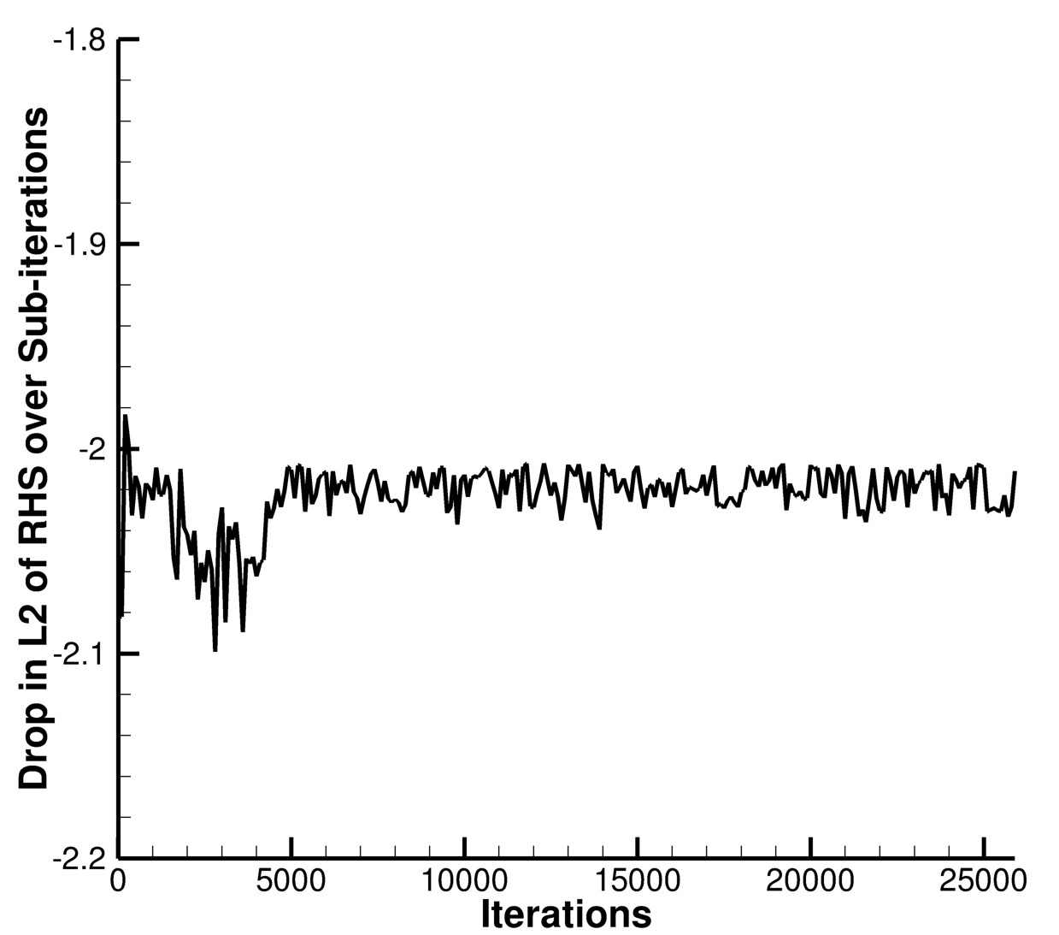
Sample Residual Convergence Plots
RANS With Rotor Disk
DDES With Resolved Blades
Notes:
Make alpha = 45 versions

Slide 11
Outline
Background
Automated Mesh Generation with EPOGS
Computational Methodology
Post-Test CFD Results
  RANS with Rotor Disk Model
  Adaption and URANS with Rotor Disk Model
  DDES with Resolved Blades
Conclusions

Slide 12
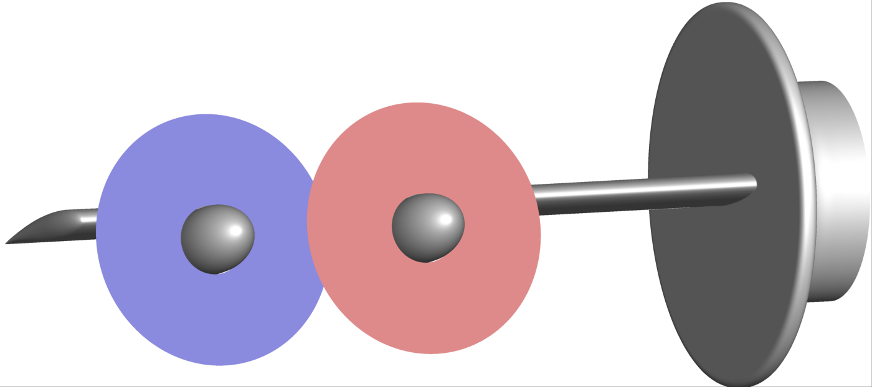
RANS With Rotor Disk
Motivation
  RANS is significantly cheaper than blade resolved runs ~19x
  Pre-test result showed reasonable agreement with blade resolved simulations*
  Assess the accuracy of using the Rotor disk model and identify potential improvements
Method
  Compare Overflow results against experimental data across a series of different studies that were performed during the wind tunnel test
    Variation of the free stream velocity
    Variation of the collective (via modifying thrust input)
    Hysteresis
*AIAA 2025-3384 for details on pre-test CFD
Notes:
Point out that we weren’t able to get any converged 60 degree solutions

Slide 13
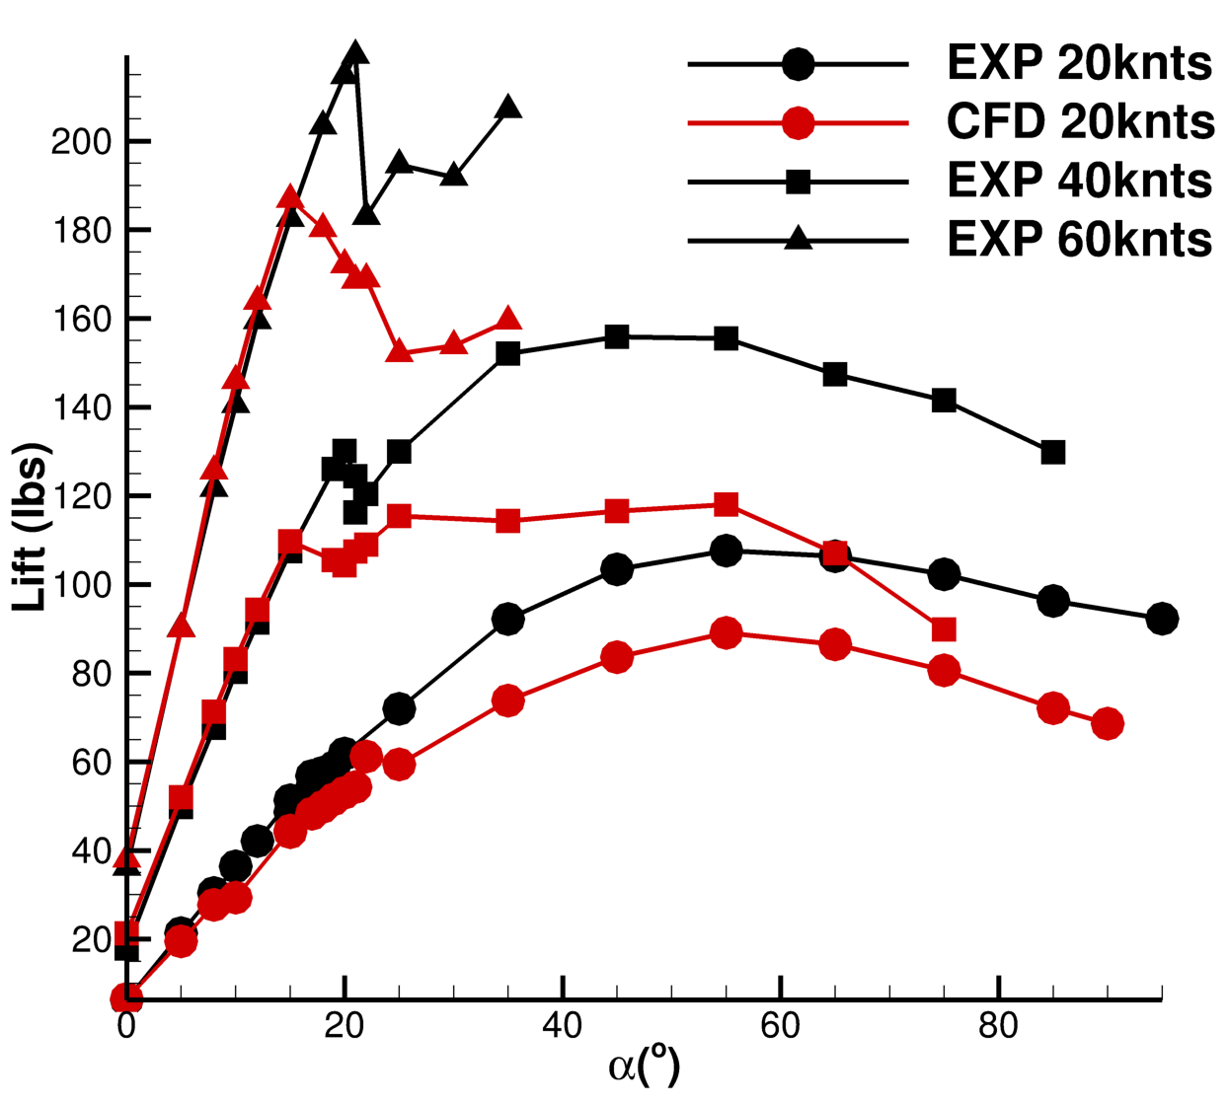
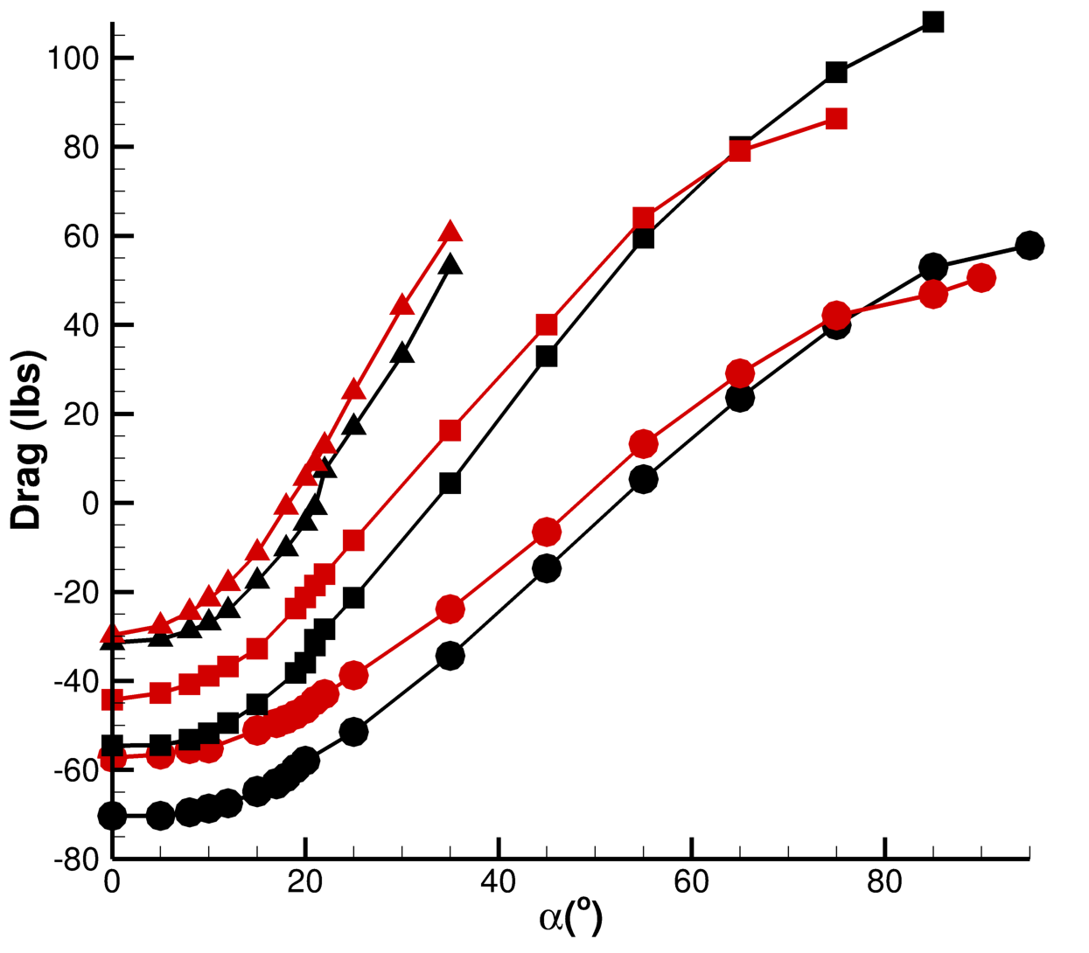
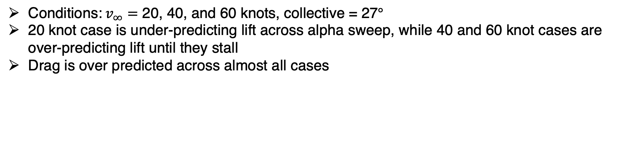
Free Stream Variation Study – Lift and Drag Comparisons
Conditions:$v_{∞}=$ 20, 40, and 60 knots, collective = 27$°$
20 knot case is under-predicting lift across alpha sweep, while 40 and 60 knot cases are over-predicting lift until they stall
Drag is over predicted across almost all cases
Notes:
Explain experimental trend first, then talk to CFD comparison. Mention early stall and that it’s not doing well at predicting Clmax (angle or magnitude)

Slide 14
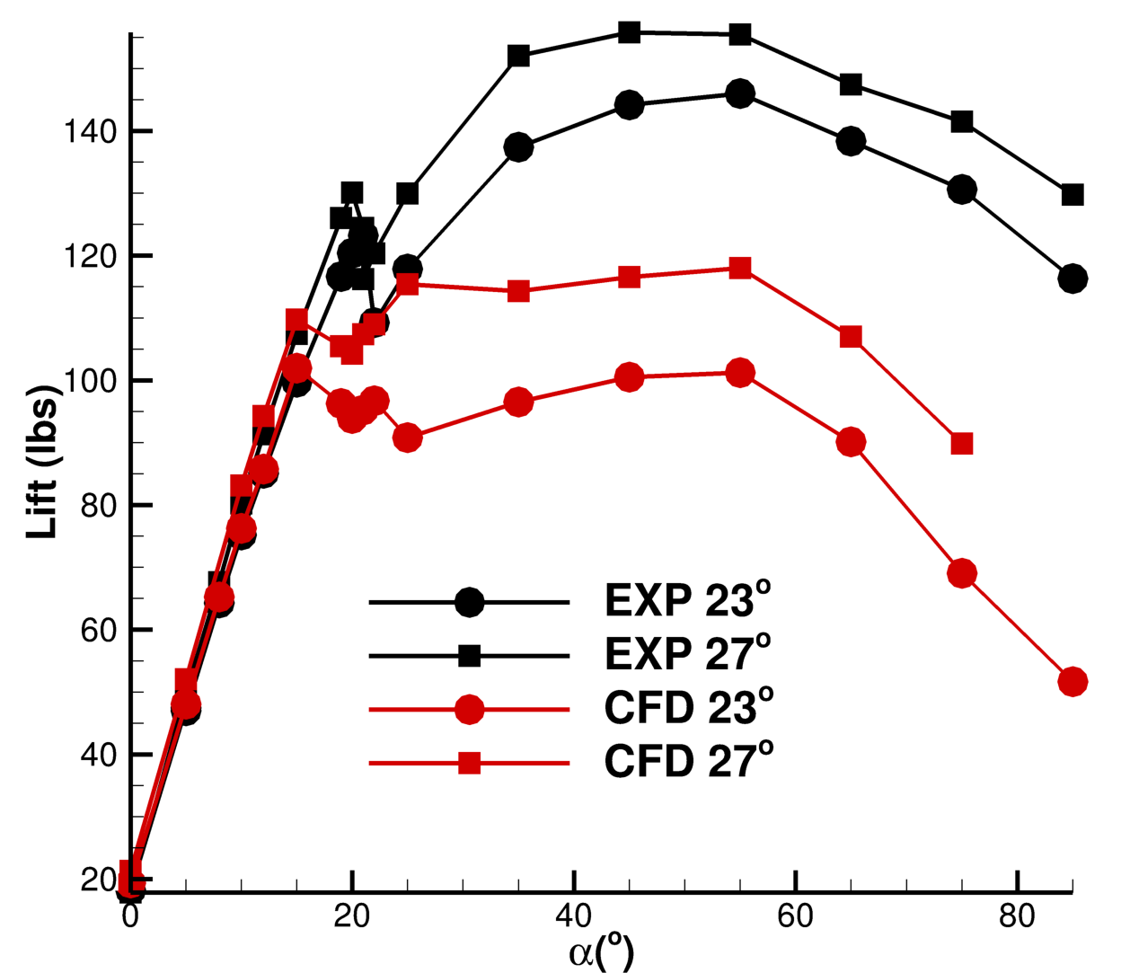
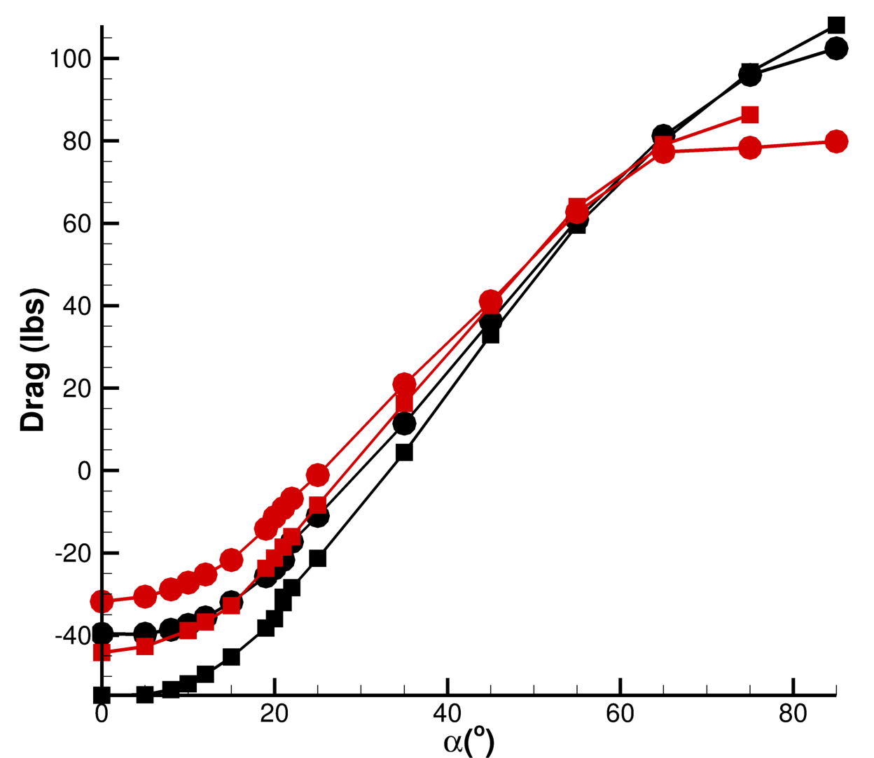
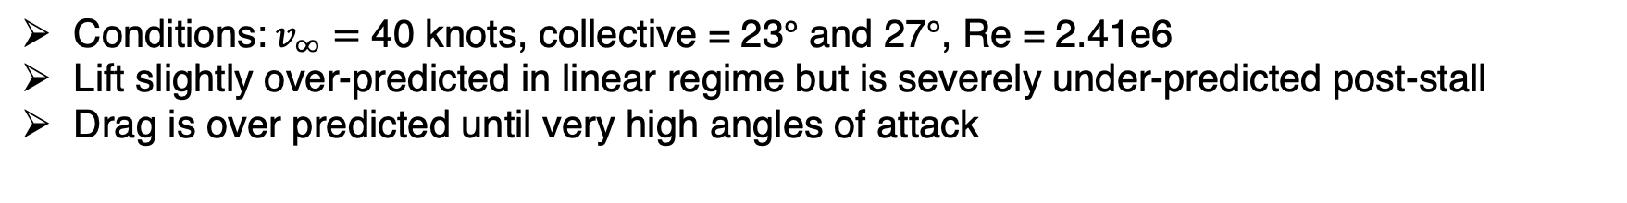
Collective Variation Study – Lift and Drag Comparisons
Conditions:$v_{∞}=$ 40 knots, collective = 23$°$ and 27$°$, Re = 2.41e6
Lift slightly over-predicted in linear regime but is severely under-predicted post-stall
Drag is over predicted until very high angles of attack

Slide 15
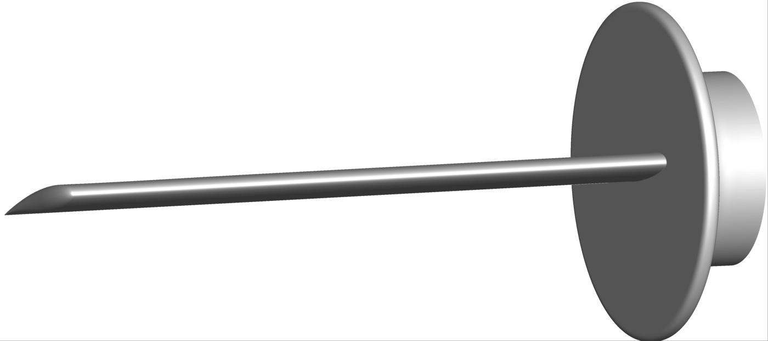
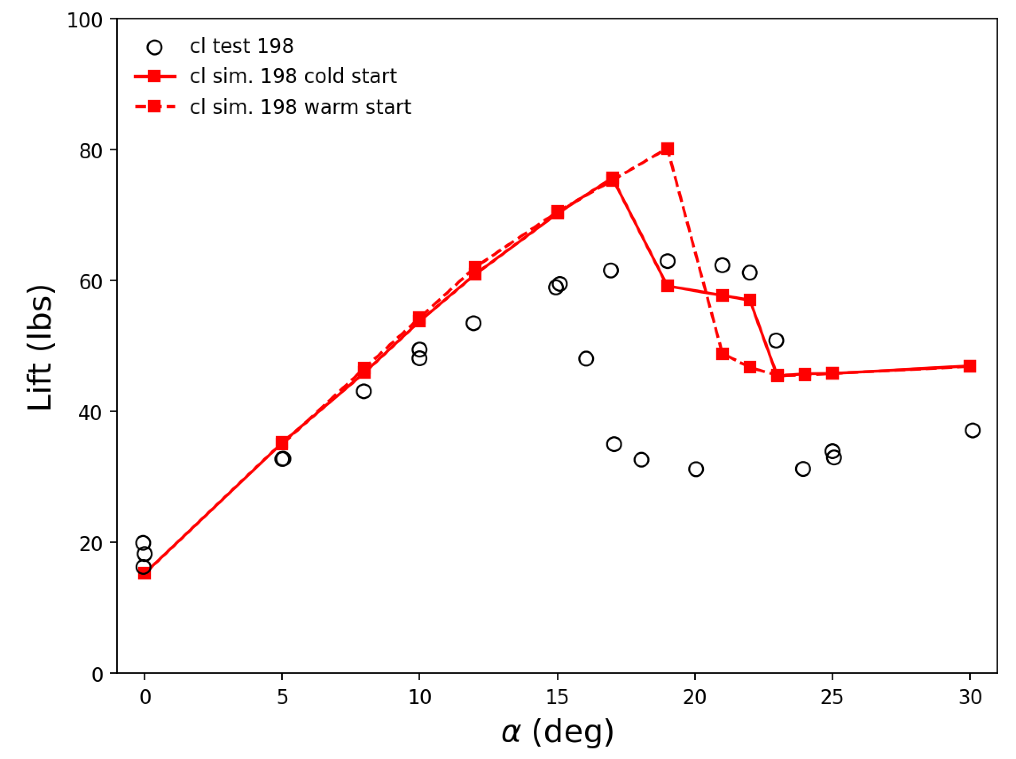
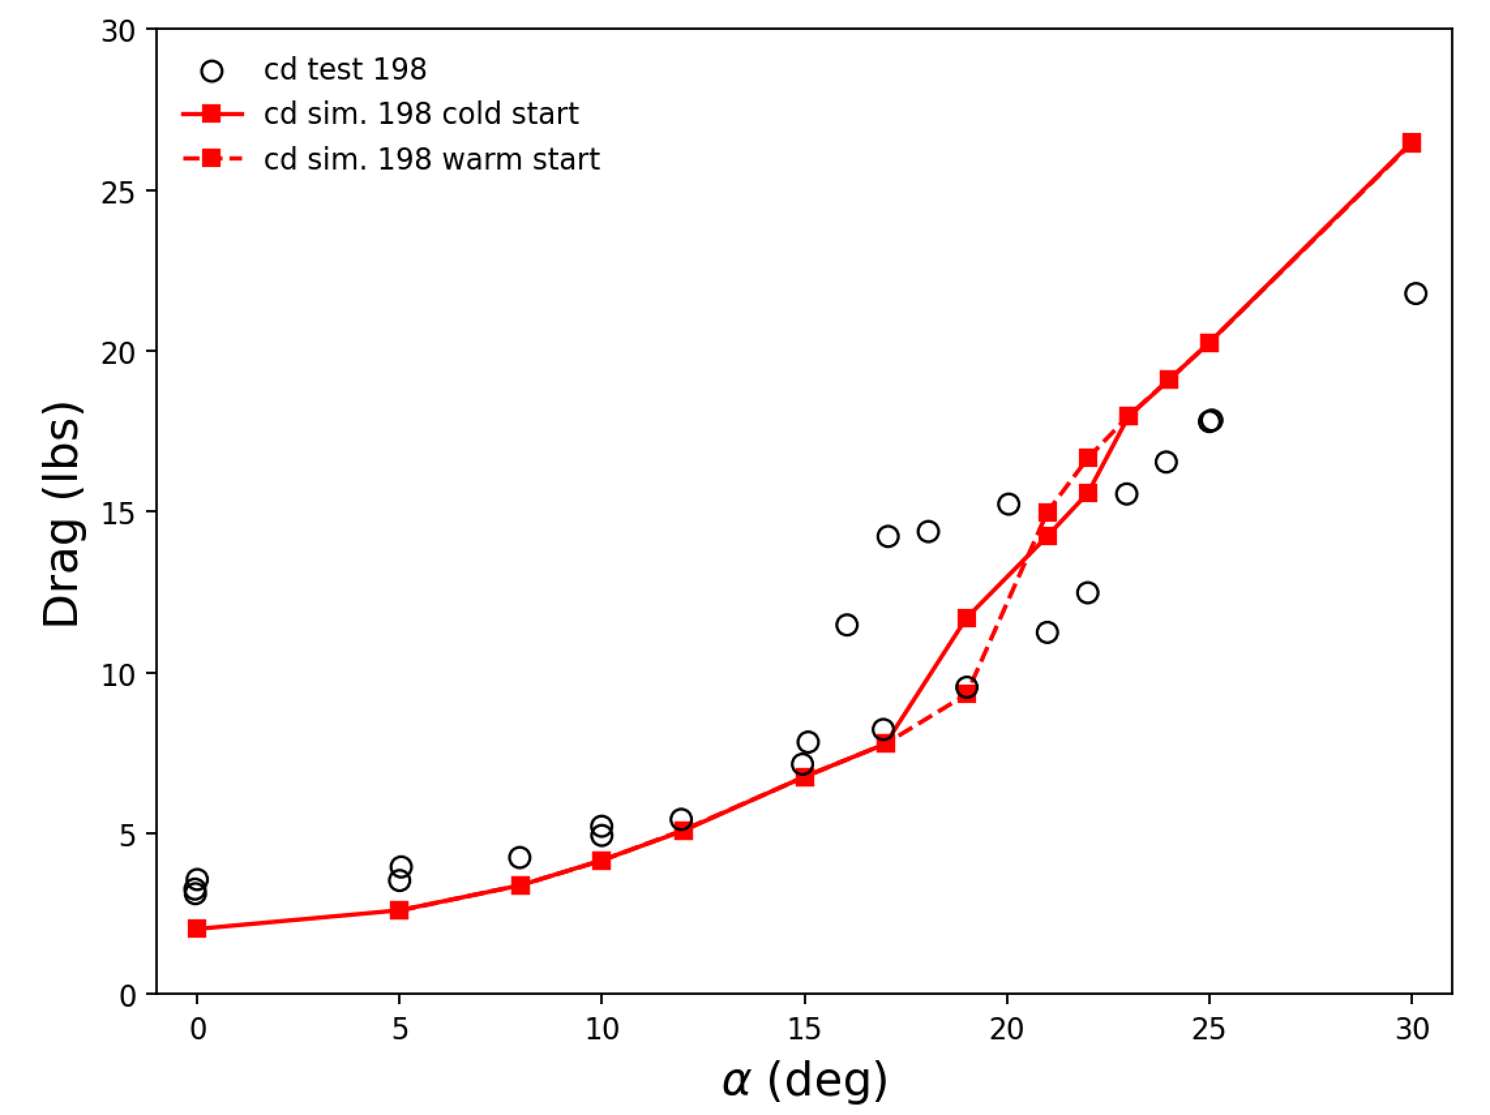
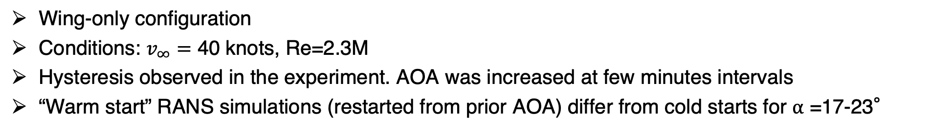
Hysteresis
Wing-only configuration
Conditions: $v_{∞}=$ 40 knots, Re=2.3M
Hysteresis observed in the experiment. AOA was increased at few minutes intervals
“Warm start” RANS simulations (restarted from prior AOA) differ from cold starts for ⍺ =17-23°

Slide 16
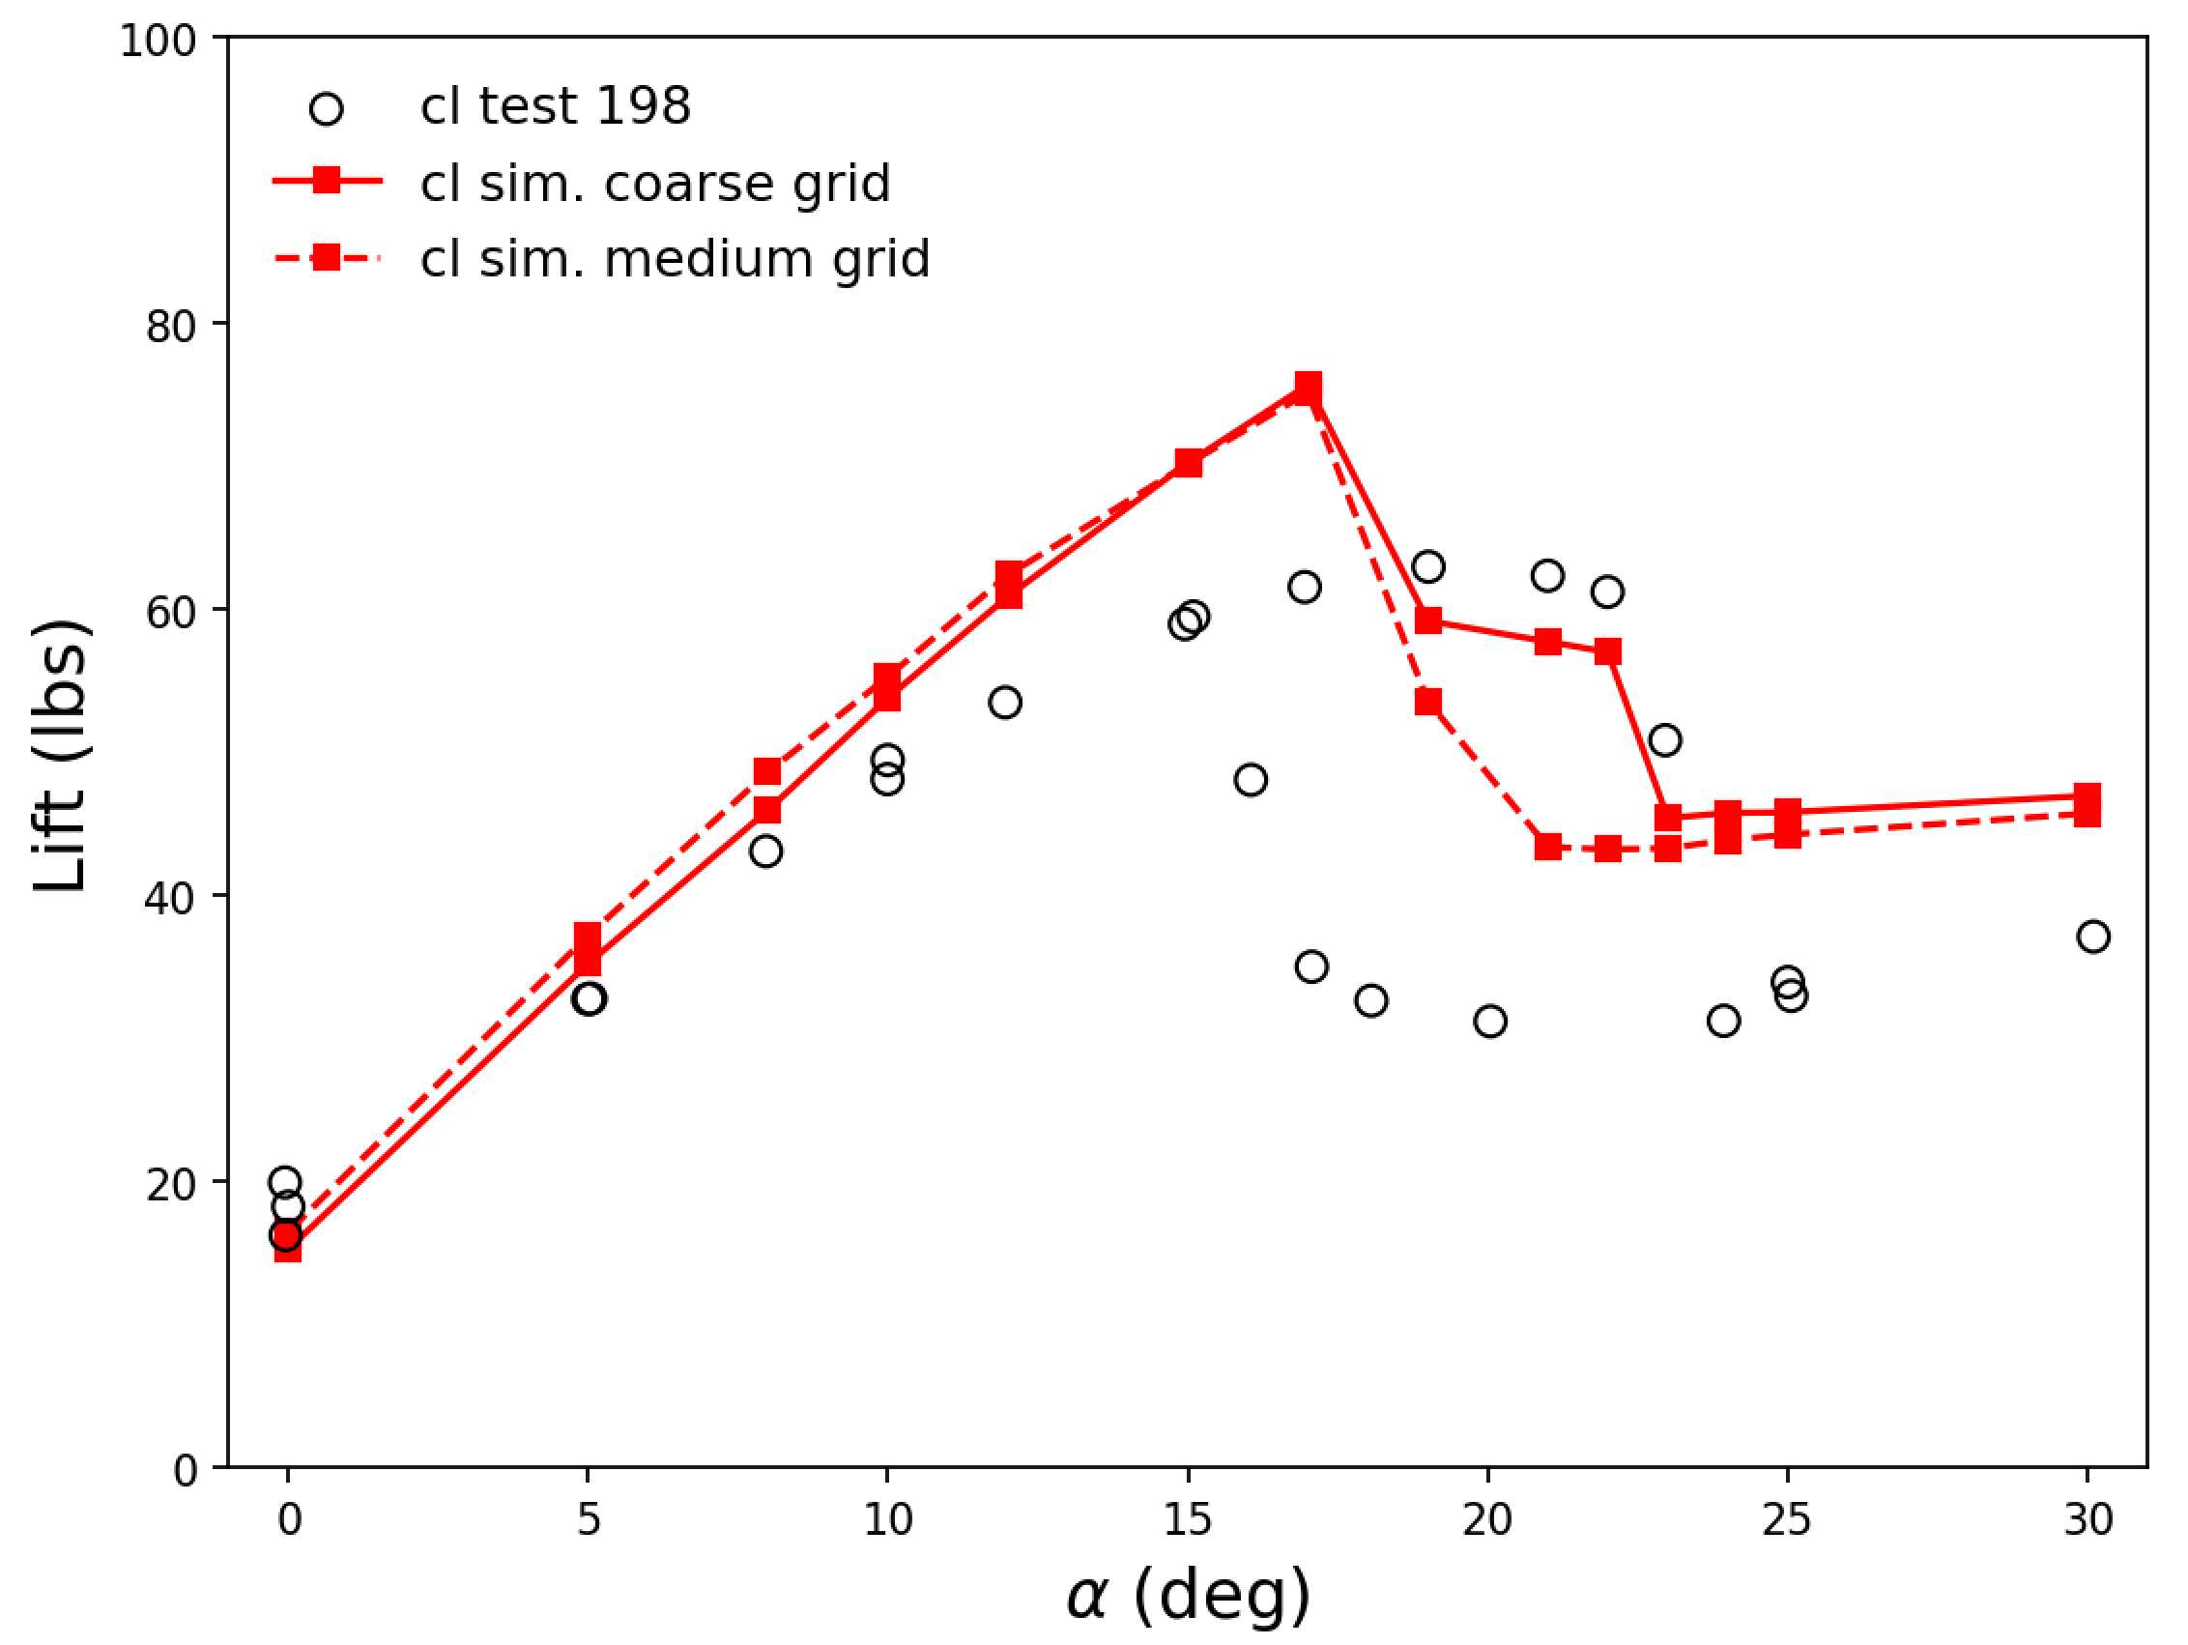
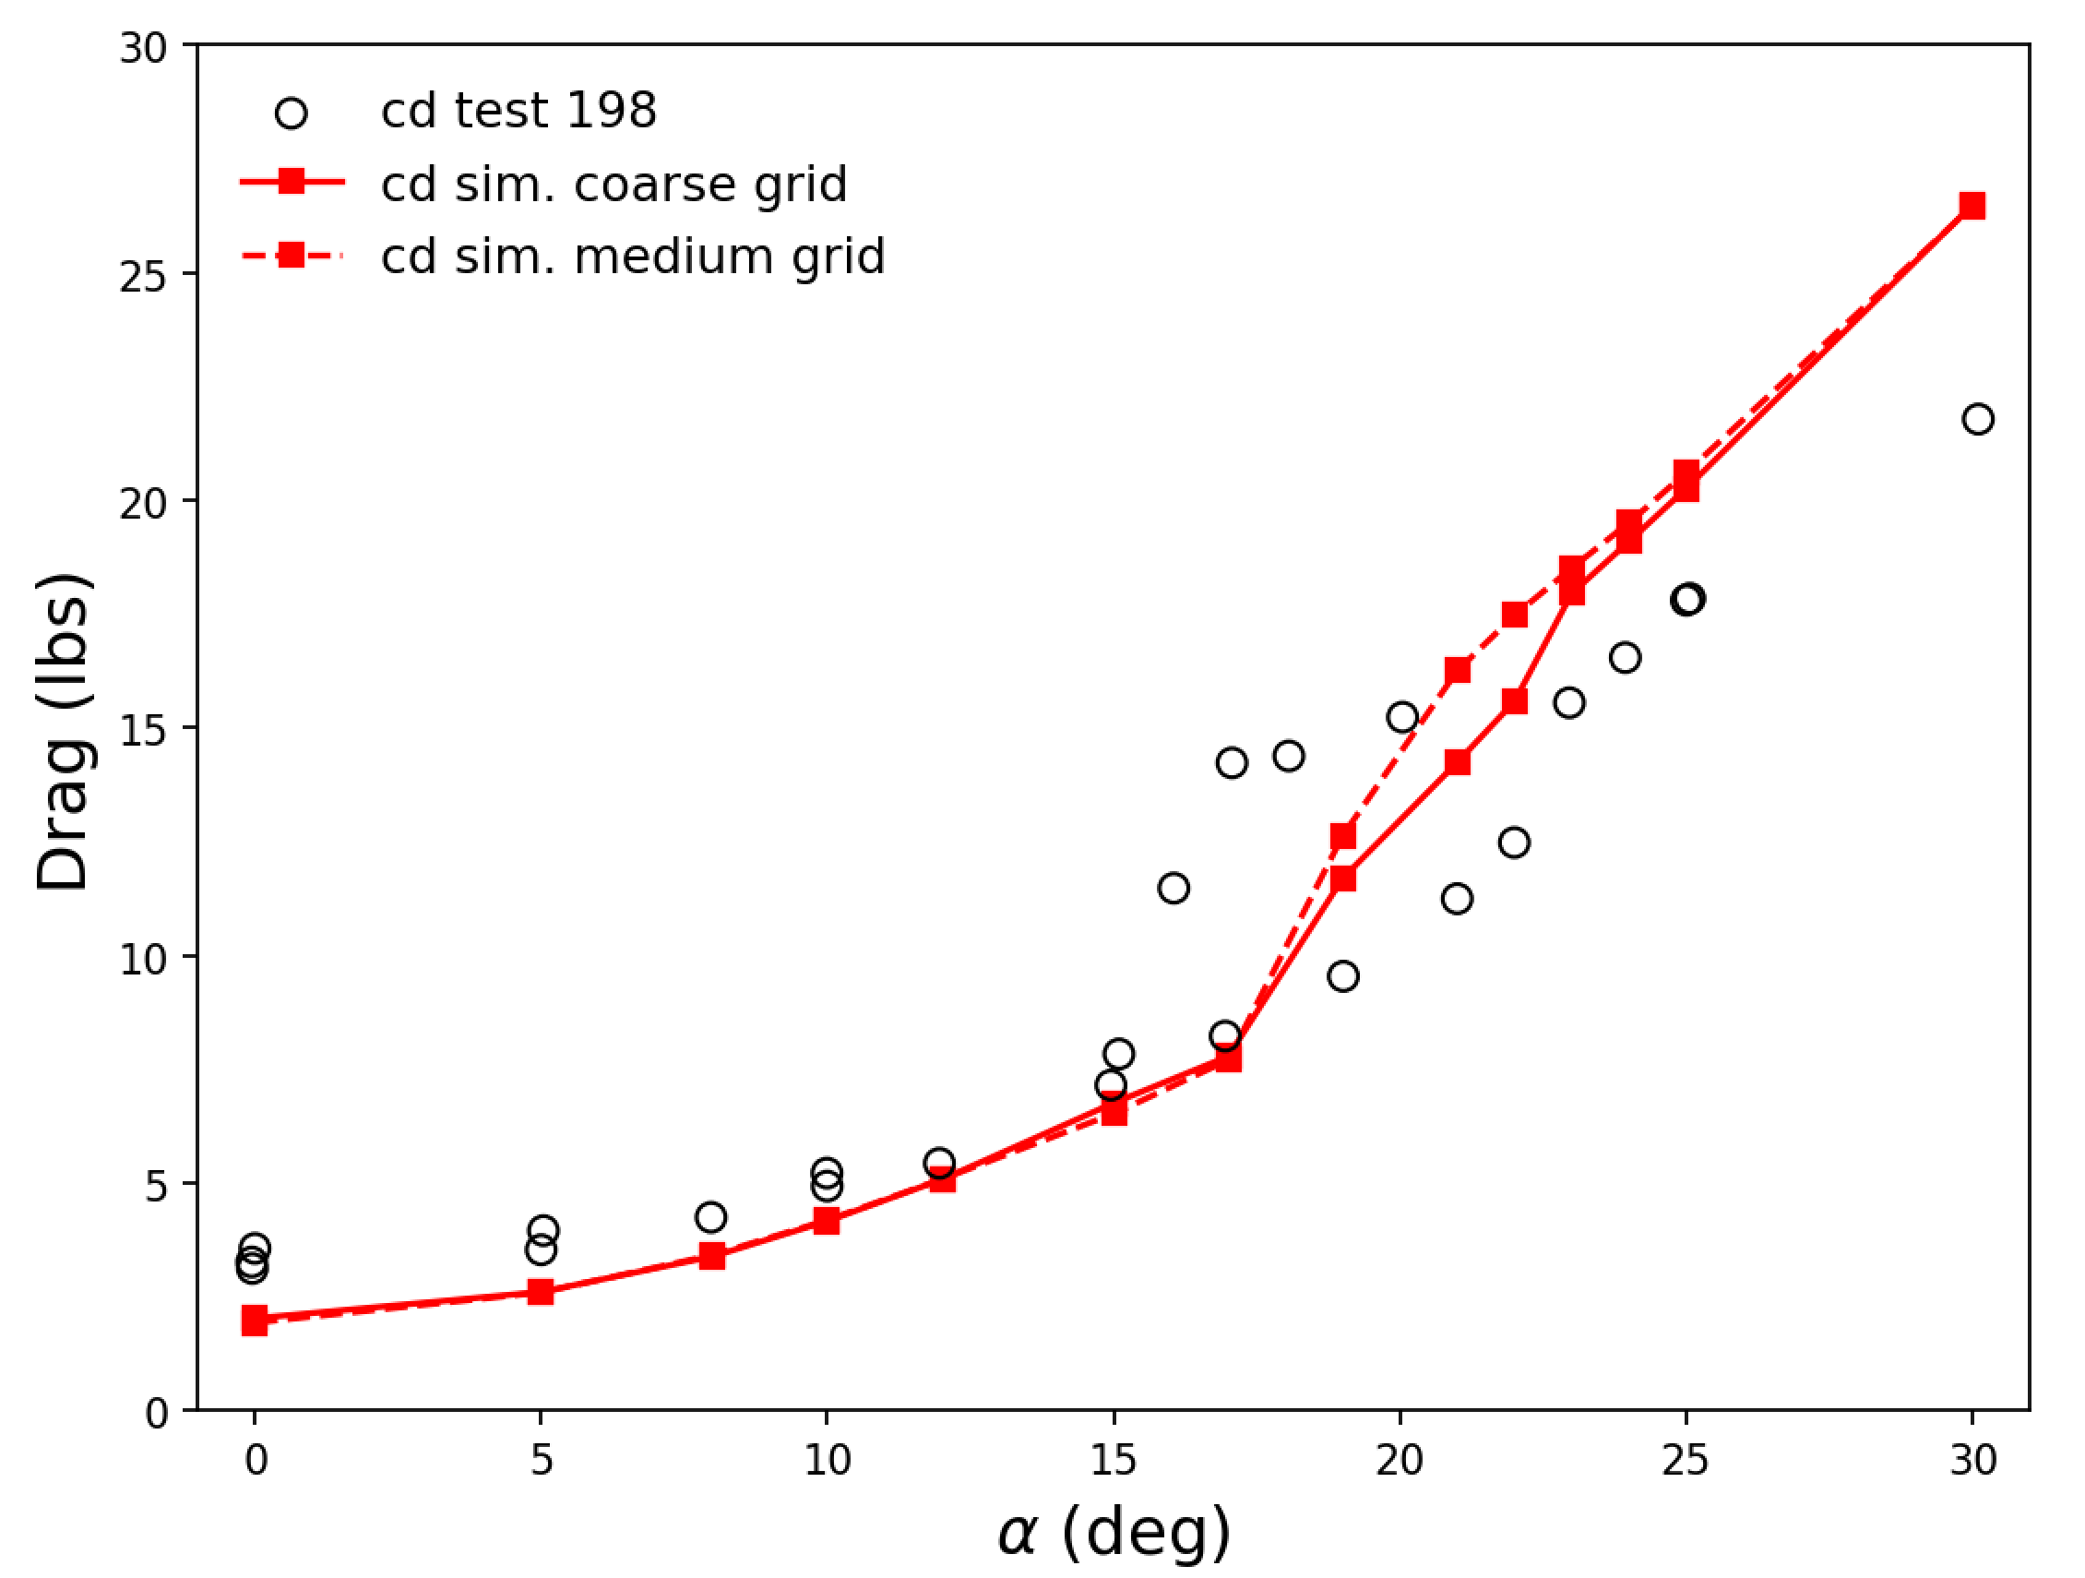
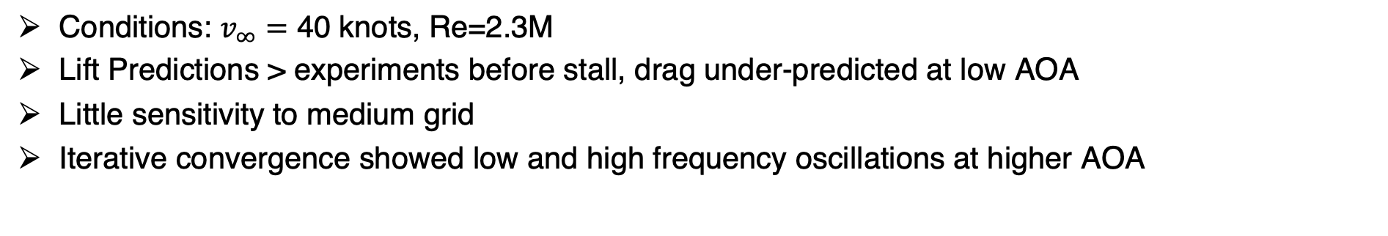
Manual Mesh Refinement
Conditions: $v_{∞}=$ 40 knots, Re=2.3M
Lift Predictions > experiments before stall, drag under-predicted at low AOA
Little sensitivity to medium grid
Iterative convergence showed low and high frequency oscillations at higher AOA
Notes:
Medium mesh had poorer convergence than the coarse mesh

Slide 17
Outline
Background
Automated Mesh Generation with EPOGS
Computational Methodology
Post-Test CFD Results
  RANS with Rotor Disk Model
  Adaption and URANS with Rotor Disk Model
  DDES with Resolved Blades
Conclusions

Slide 18
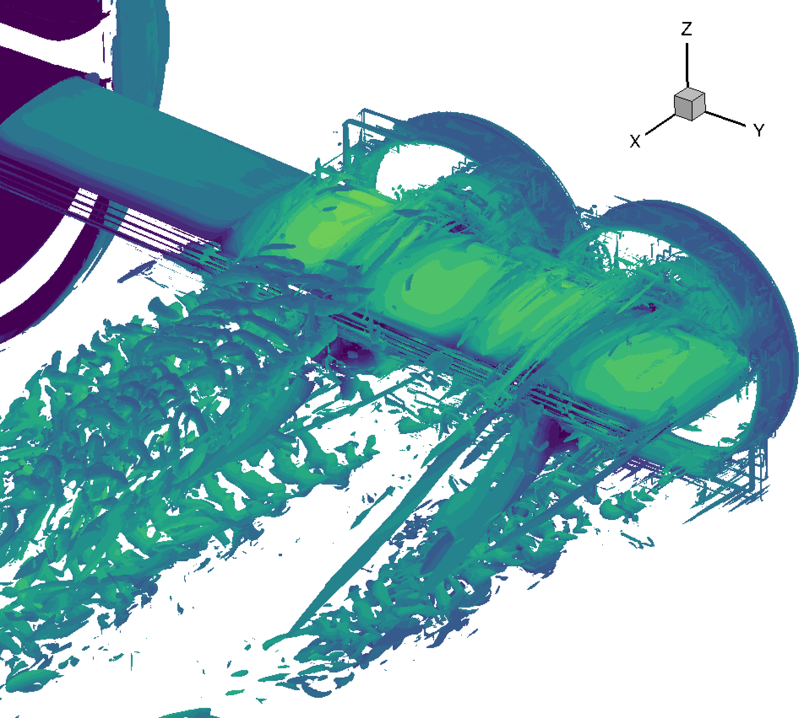
Adaptive Mesh Refinement
Configuration: Clean wing, nacelles, and actuator disks
Adaption Strategies:
  500M, 350M, 200M nodes (7, 5, 3 X original grid)
  2-3 levels of refinement
  AMR in refinement boxes around wing and nacelles
  Near body refinement restrictions:
    All body-fitted grids (L>30)
    Trailing edge body fitted grids (L>30)
  Combination with URANS (in progress)
Q-Criterion (0.03)
2-Level AMR

Slide 19
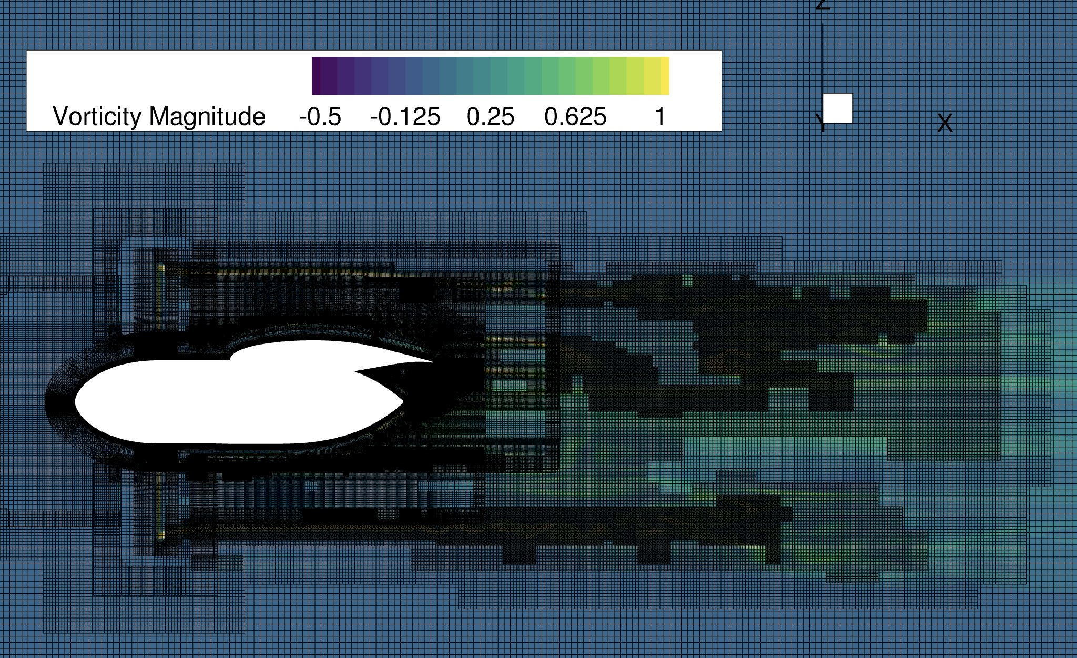
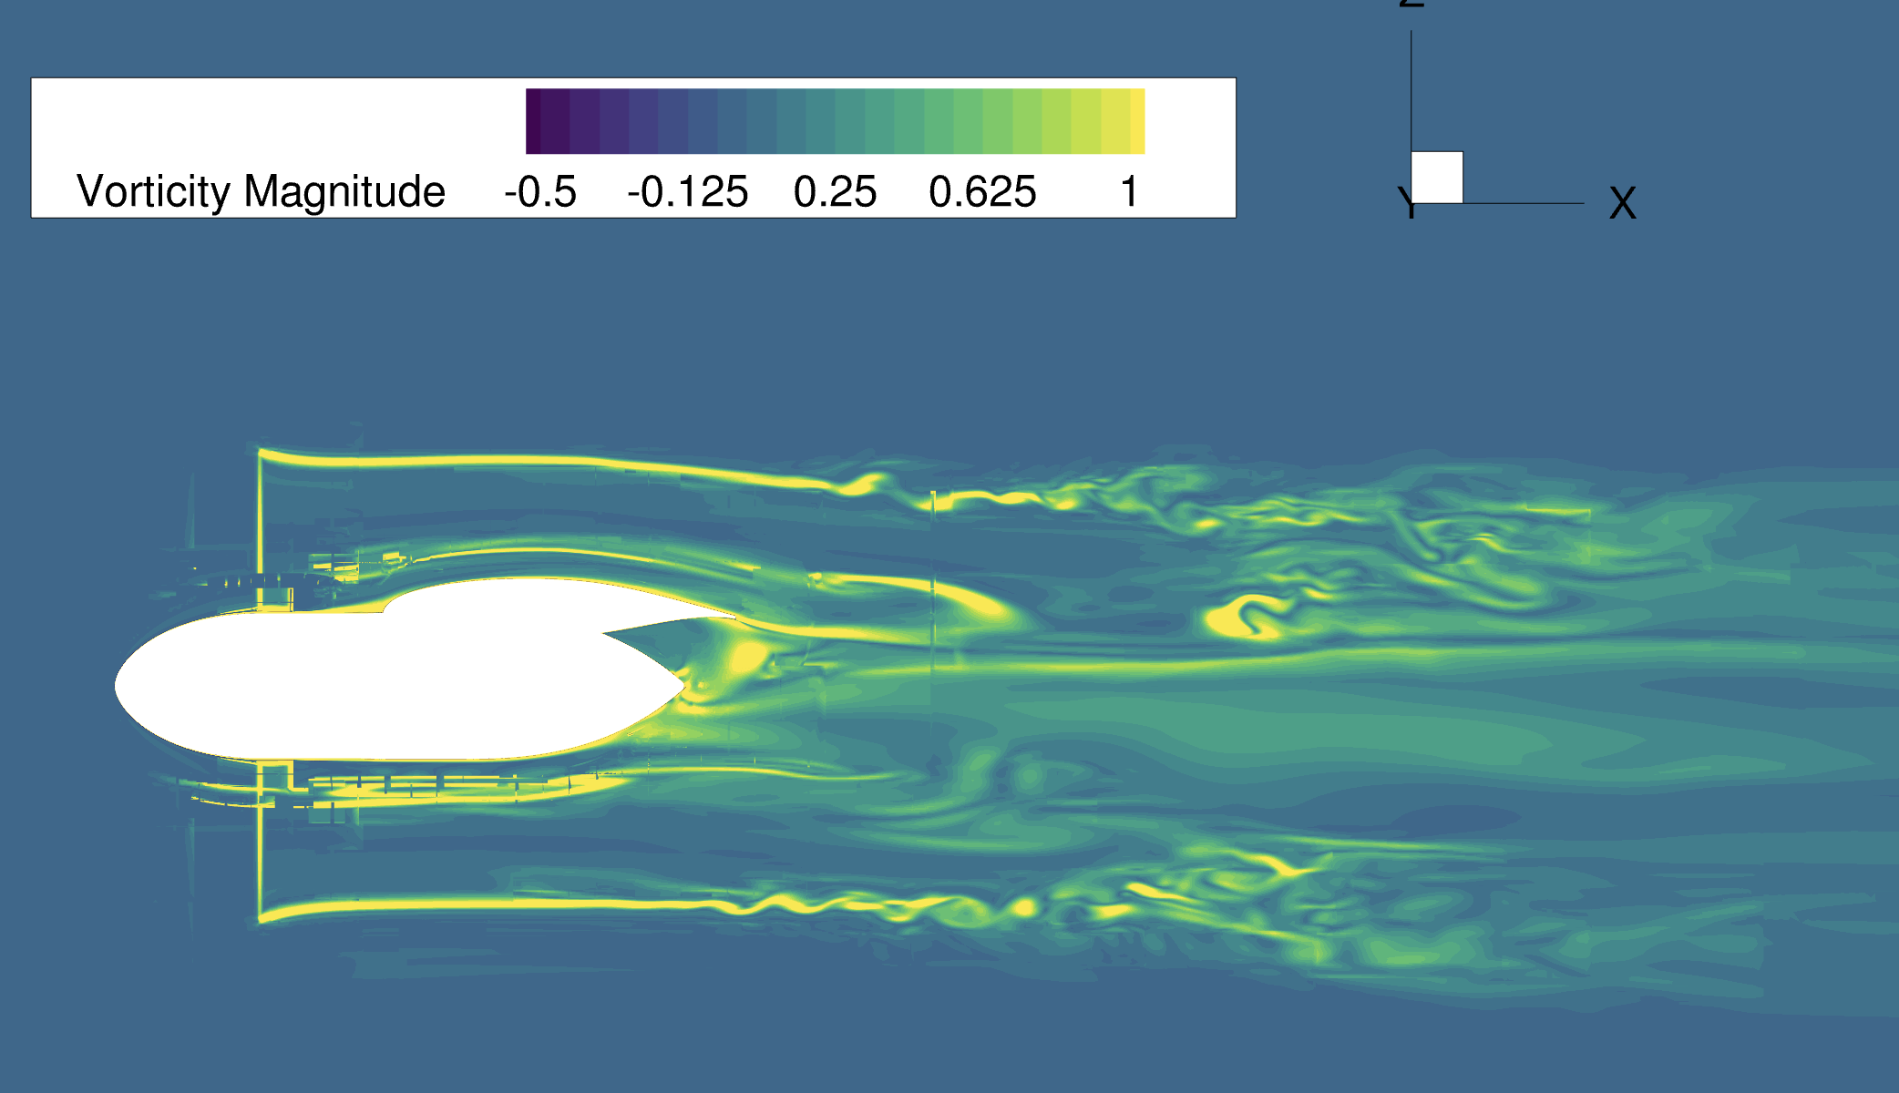
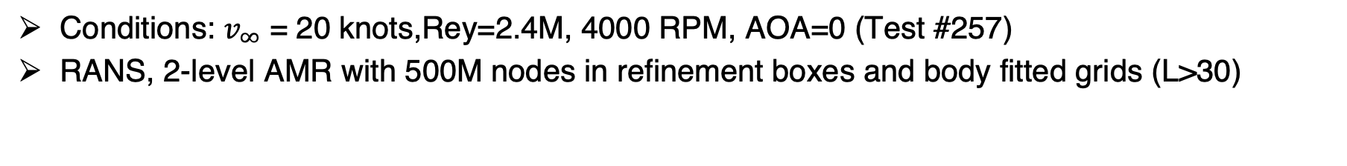
Adaptive Mesh Refinement: Wake Resolution
Conditions: $v_{∞}$ = 20 knots,Rey=2.4M, 4000 RPM, AOA=0 (Test #257)
RANS, 2-level AMR with 500M nodes in refinement boxes and body fitted grids (L>30)

Slide 20
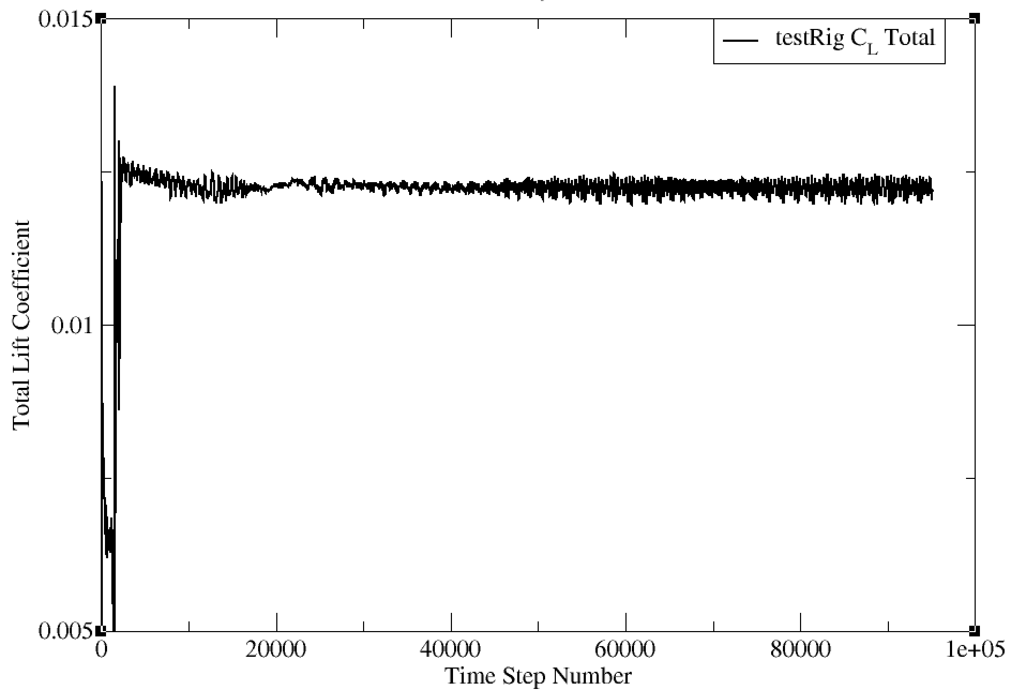
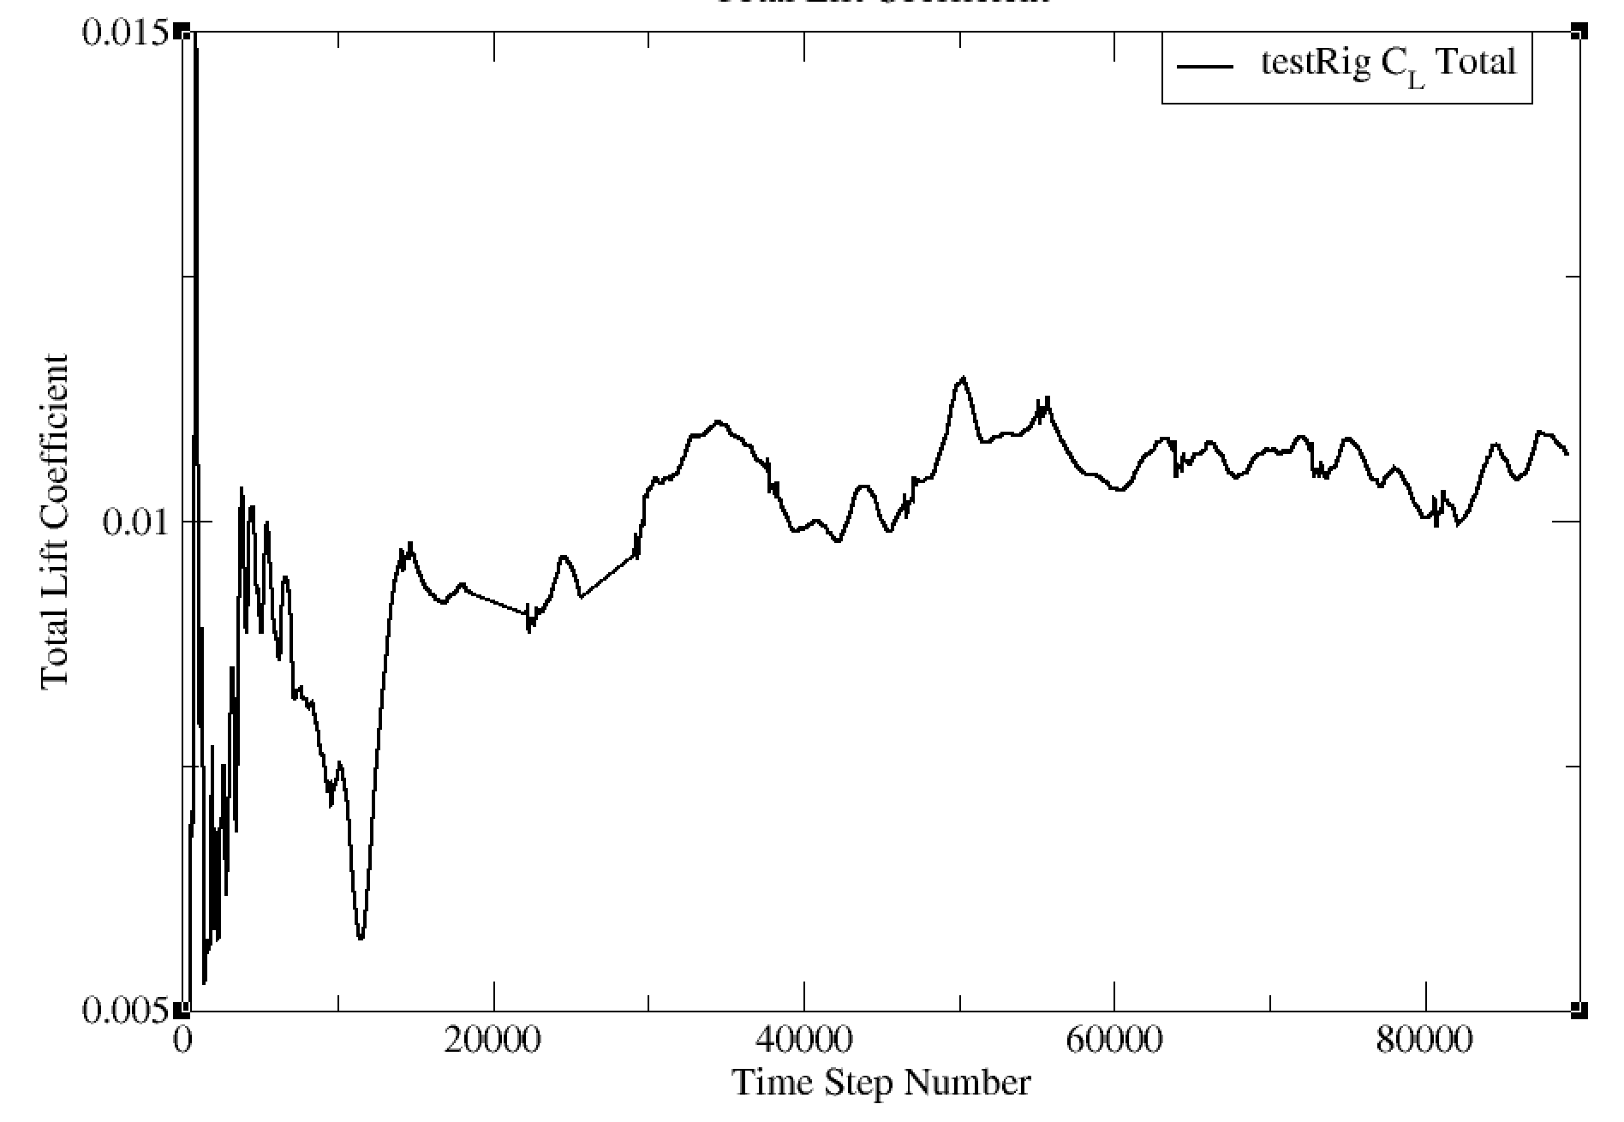
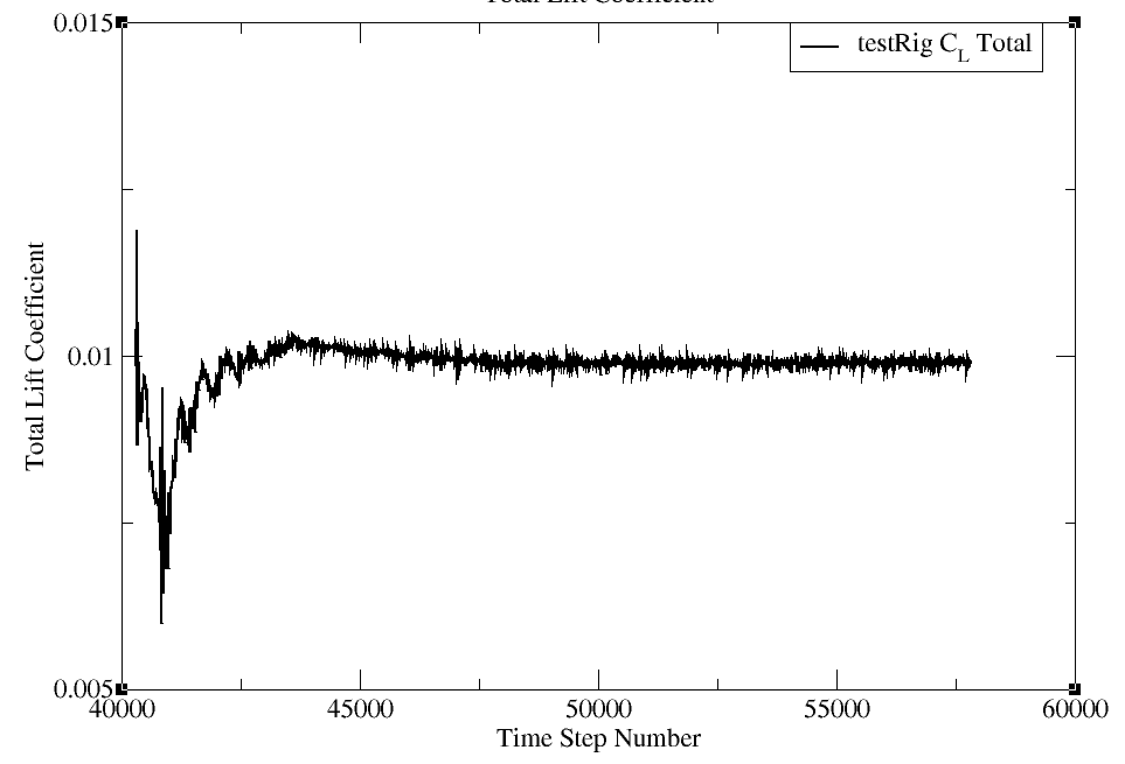
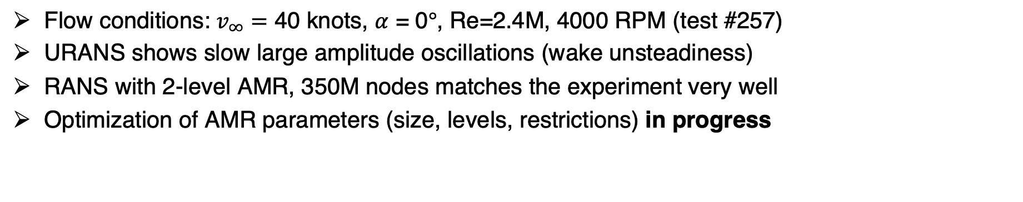
Adaptive Mesh Refinement: Iterative Convergence
Flow conditions: $v_{∞}=$ 40 knots, $α$ = 0$°$, Re=2.4M, 4000 RPM (test #257)
URANS shows slow large amplitude oscillations (wake unsteadiness)
RANS with 2-level AMR, 350M nodes matches the experiment very well
Optimization of AMR parameters (size, levels, restrictions) in progress
 | RANS | URANS | RANS+AMR
Δ(CFD-Experiment) % | 22 | 4 | 1
Experiment
RANS
URANS
RANS+AMR
Notes:
URANS here is unadapted

Slide 21
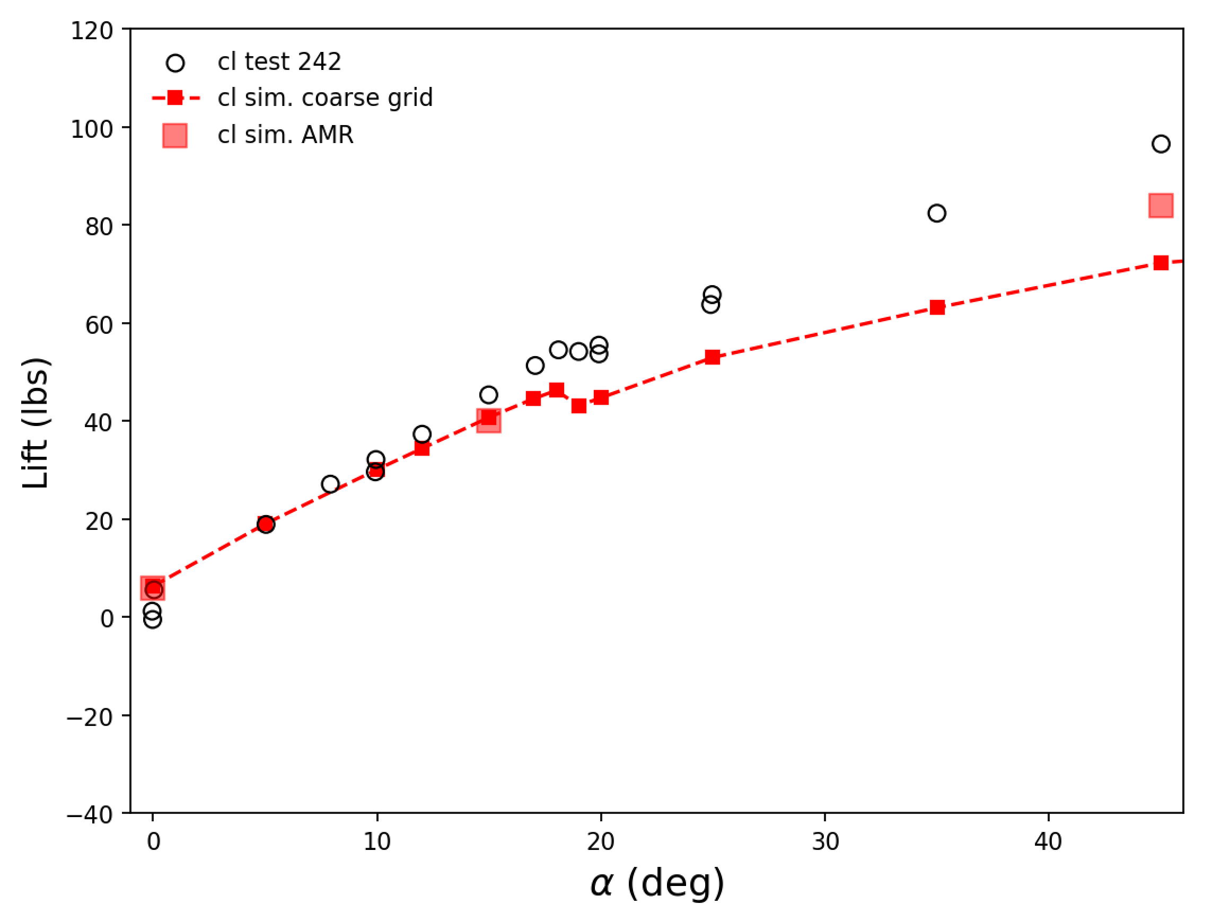
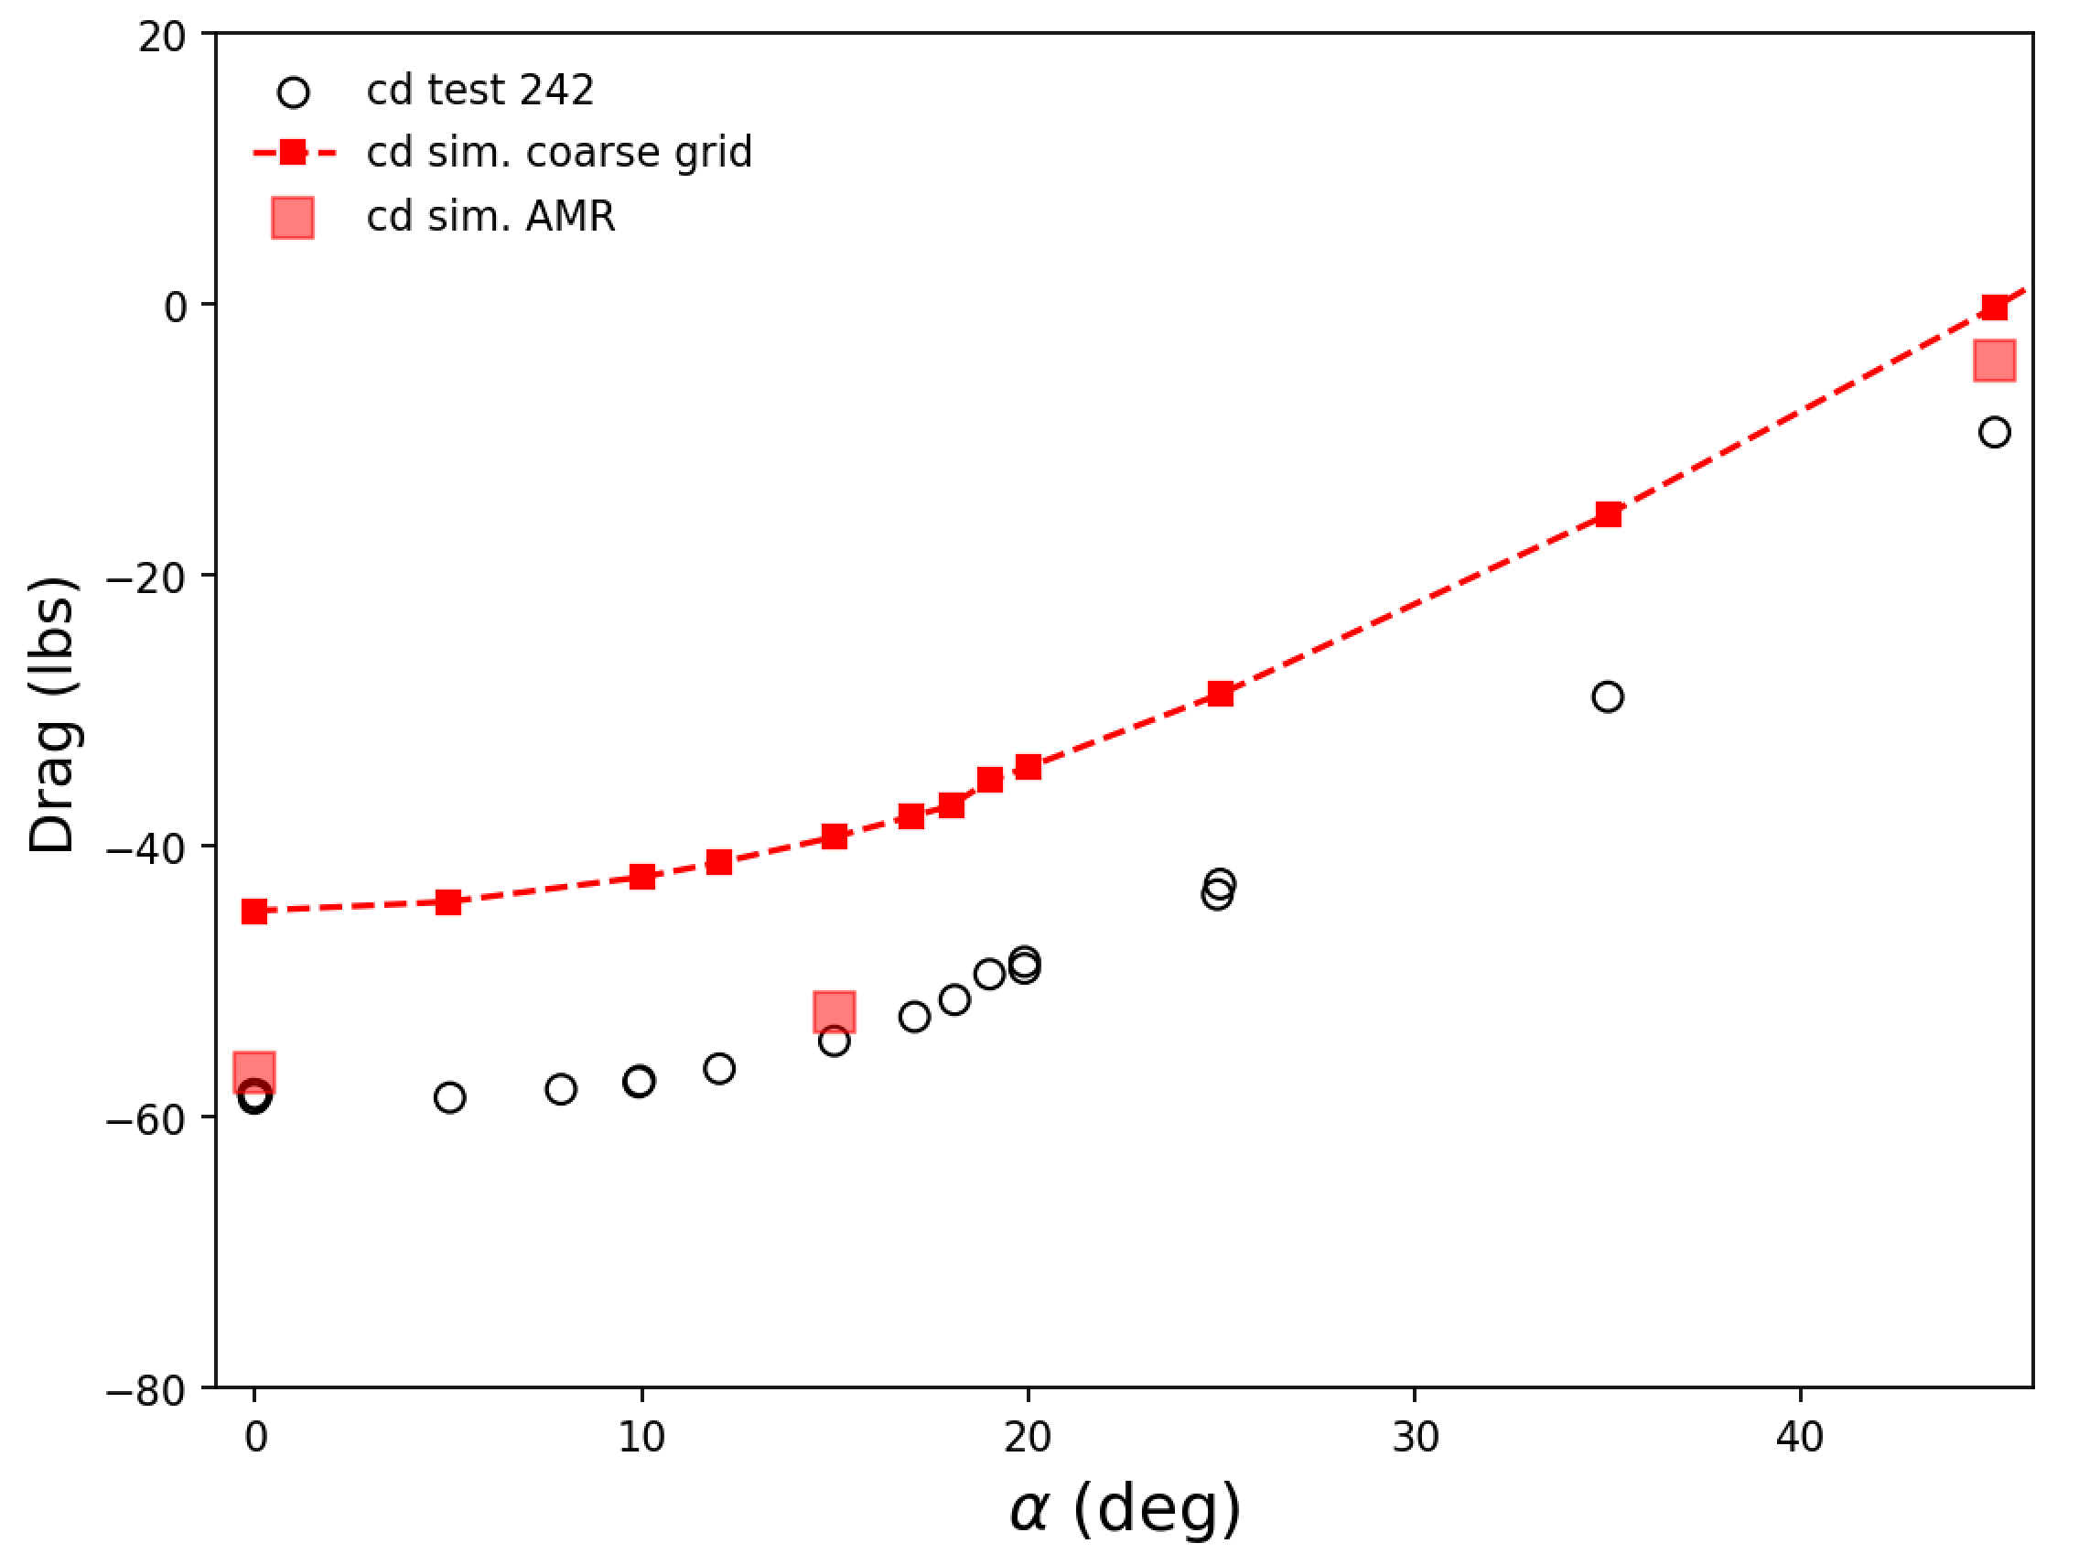
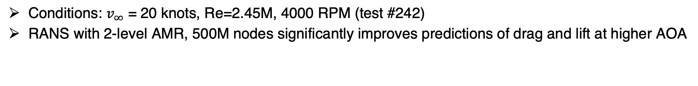
Adaptive Mesh Refinement: Load Coefficients
Conditions: $v_{∞}$ = 20 knots, Re=2.45M, 4000 RPM (test #242)
RANS with 2-level AMR, 500M nodes significantly improves predictions of drag and lift at higher AOA

Slide 22
Outline
Background
Automated Mesh Generation with EPOGS
Computational Methodology
Post-Test CFD Results
  RANS with Rotor Disk Model
  Adaption and URANS with Rotor Disk Model
  DDES with Resolved Blades
Conclusions

Slide 23
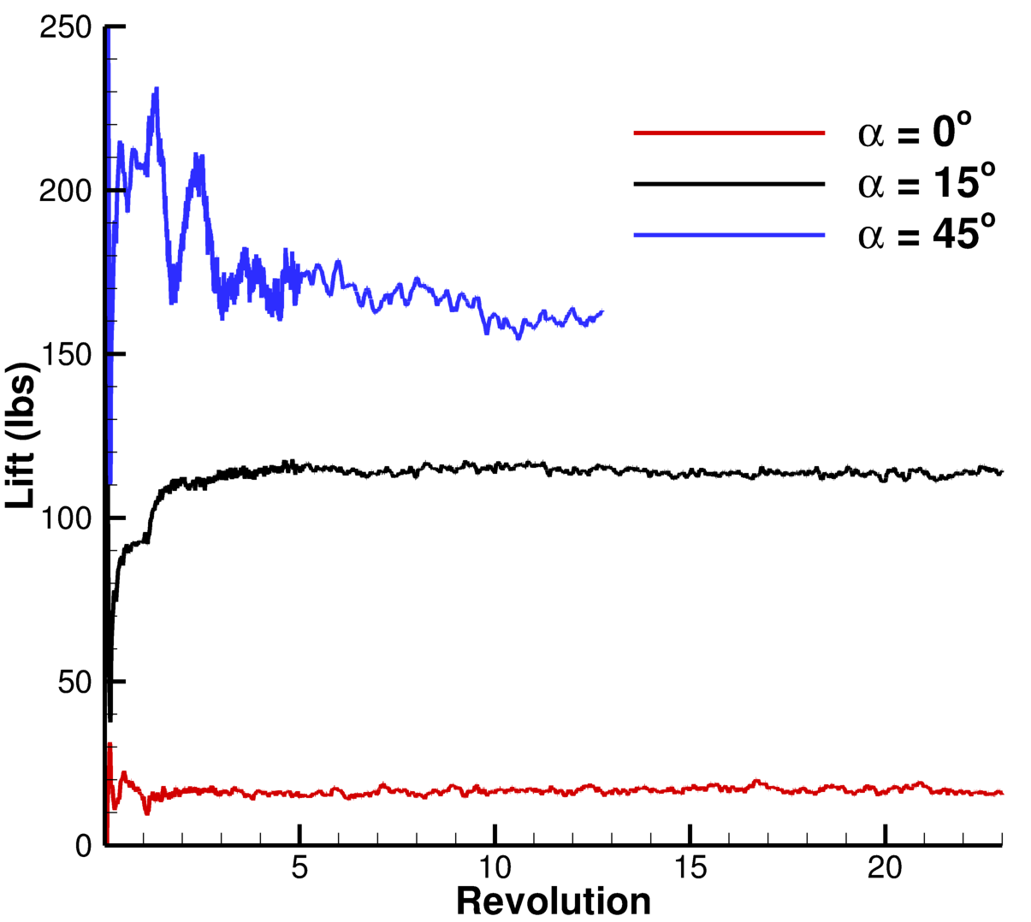
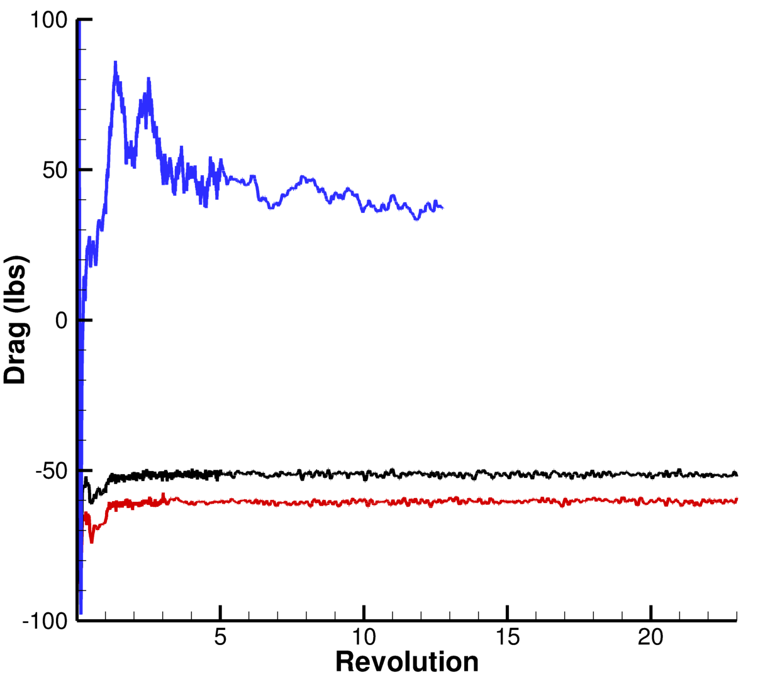
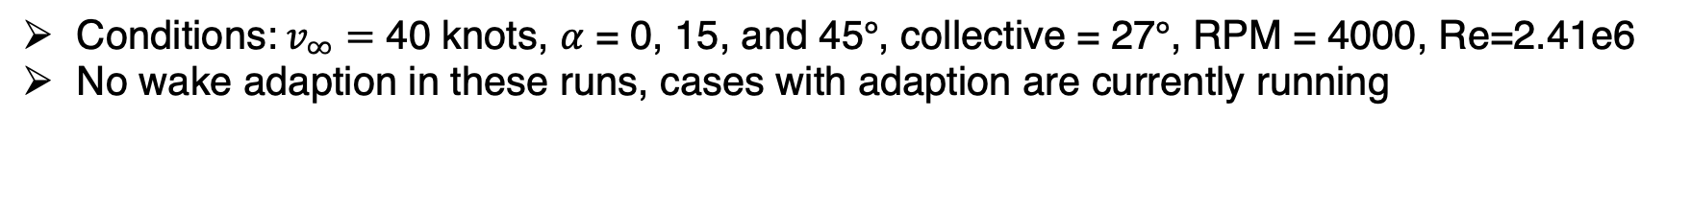
DDES Loads Convergence
Conditions:$v_{∞}=$ 40 knots, $α$ = 0, 15, and 45$°$, collective = 27$°$, RPM = 4000, Re=2.41e6
No wake adaption in these runs, cases with adaption are currently running

Slide 24
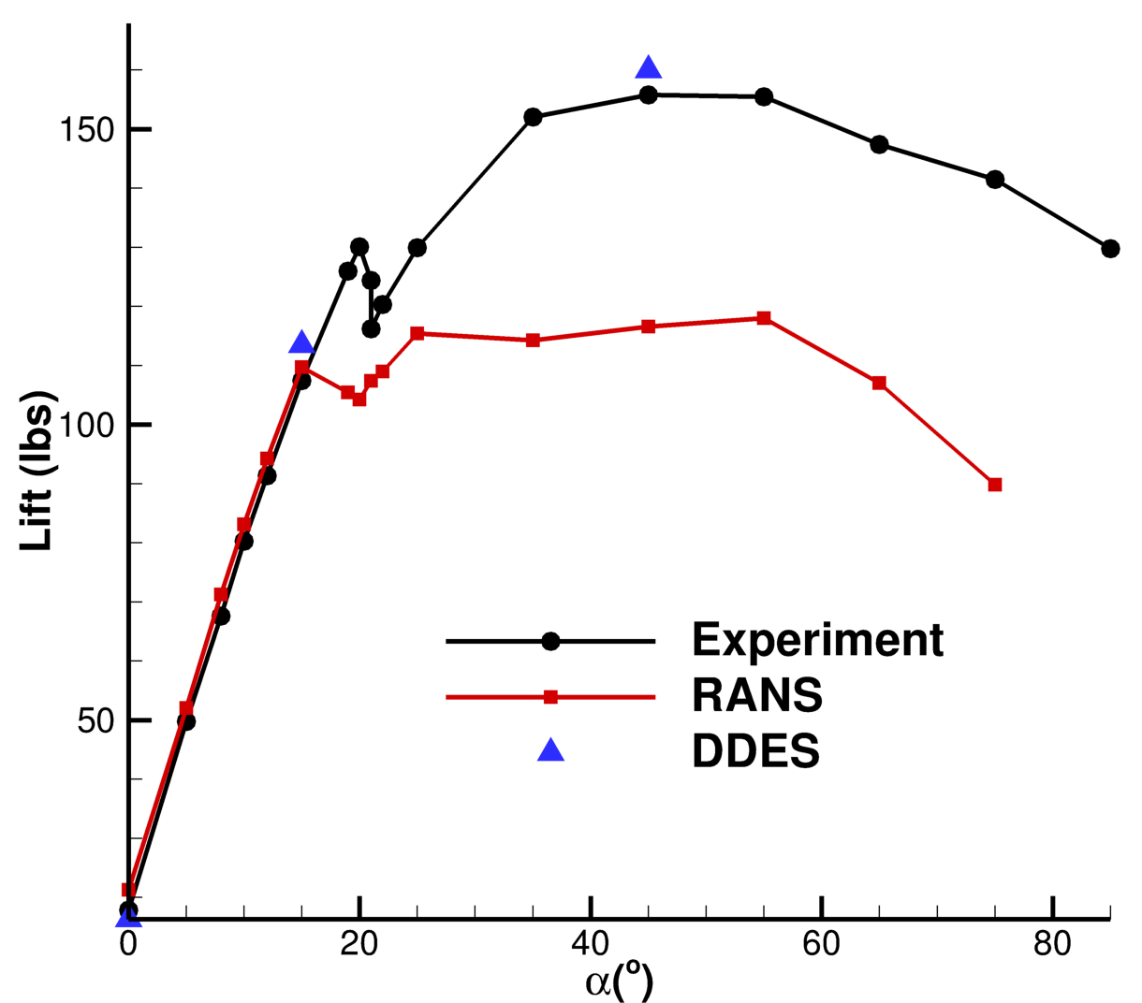
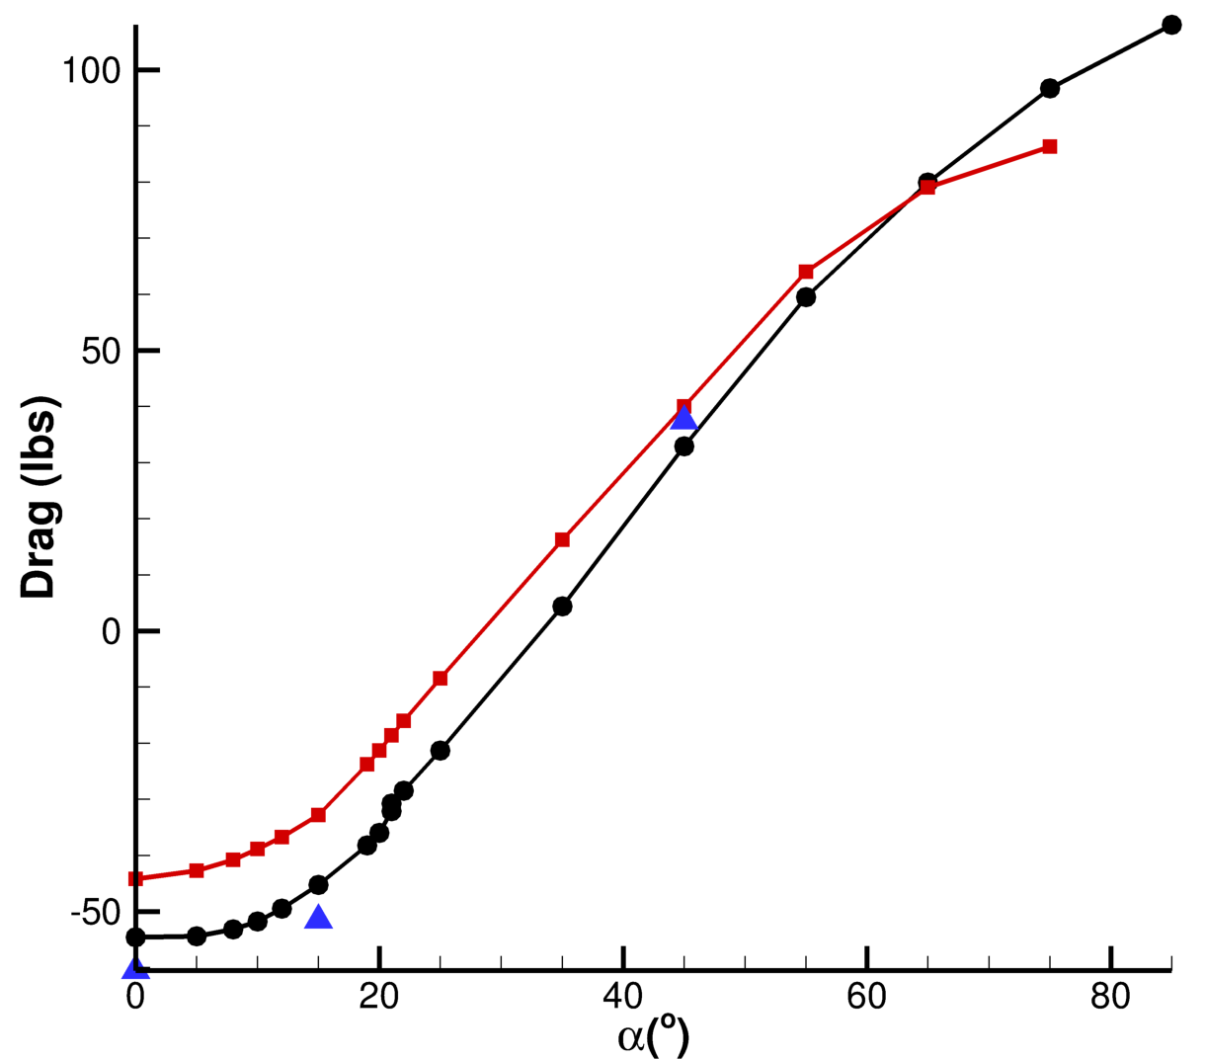
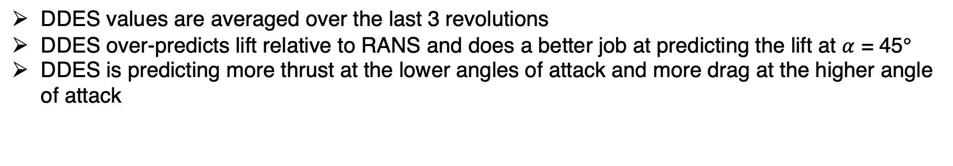
DDES Loads Comparison
DDES values are averaged over the last 3 revolutions
DDES over-predicts lift relative to RANS and does a better job at predicting the lift at $α$ = 45$°$
DDES is predicting more thrust at the lower angles of attack and more drag at the higher angle of attack

Slide 25
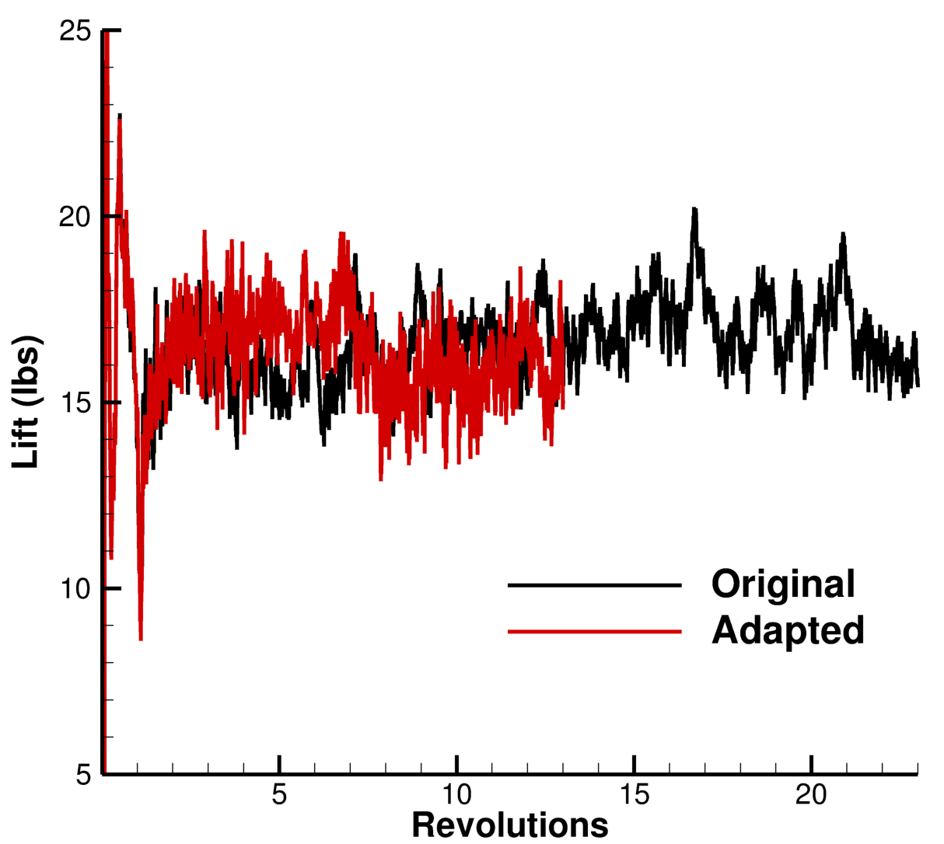
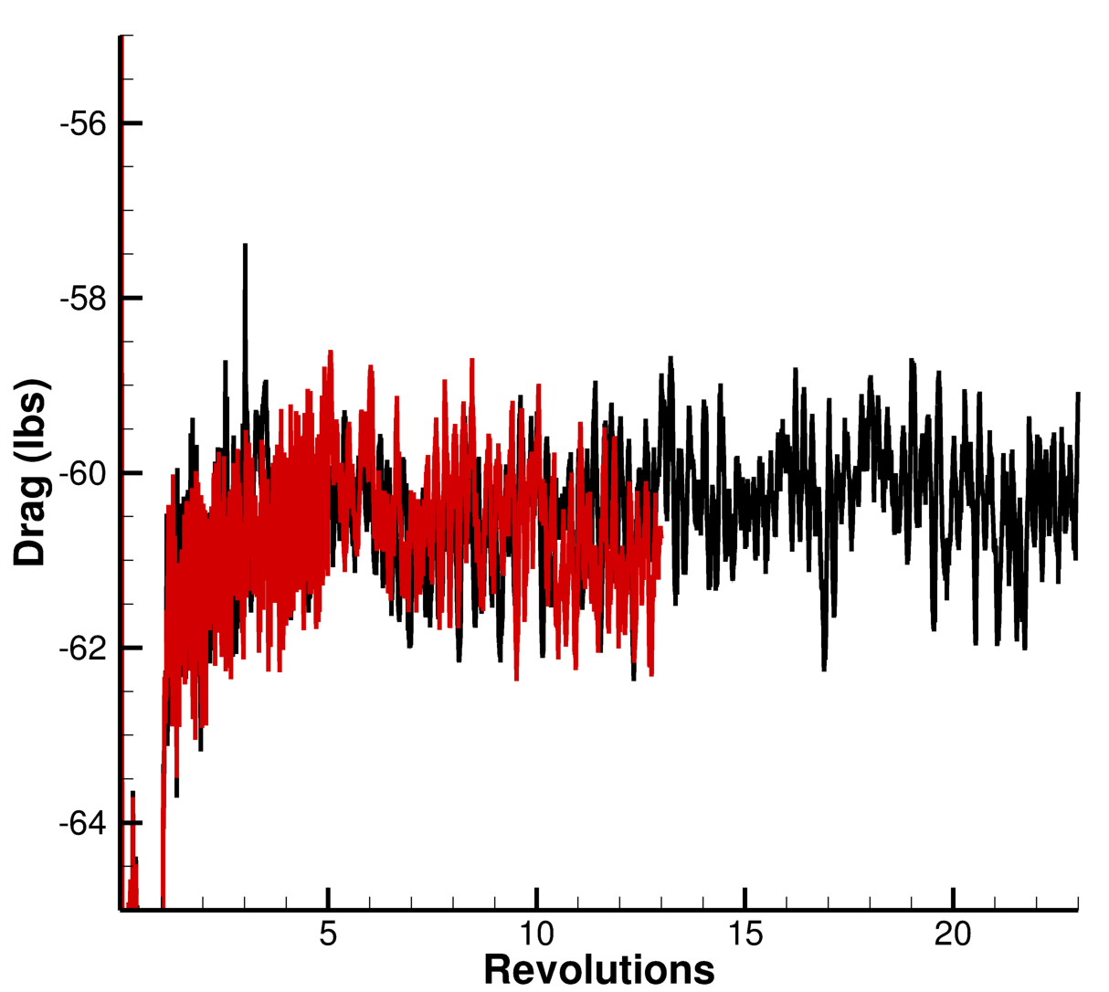
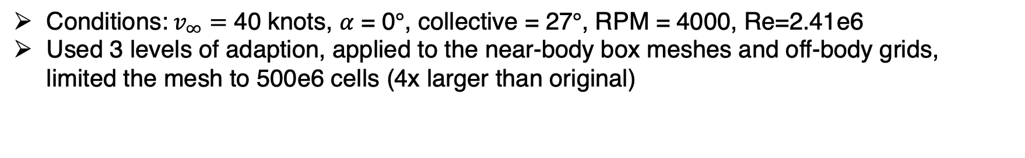
DDES with AMR Loads Convergence
Conditions:$v_{∞}=$ 40 knots, $α$ = 0$°$, collective = 27$°$, RPM = 4000, Re=2.41e6
Used 3 levels of adaption, applied to the near-body box meshes and off-body grids, limited the mesh to 500e6 cells (4x larger than original)

Slide 26




Loads Comparisons for $α$ = 0$°$
 | Lift (lbs) | % Error | Drag (lbs) | % Error
Experiment | 17.84 | - | -54.55 | -
RANS | 21.30583 | 19.43 | -44.2211189 | 18.93
DDES | 16.32215 | 8.51 | -60.50856 | 10.92
Adapted DDES | 16.76769 | 6.01 | -60.42259 | 10.77

Slide 27



Surface CP and Mach Slices
RANS
DDES
Adapted DDES
Notes:
Try to get vorticity magnitude

Slide 28
Conclusions
RANS with Rotor Disk Model
  Trends in the loads are similar to the experiment while the flow remains attached but not after separation
  Does a poor job of predicting the angle or magnitude of maximum lift
  Improves across whole alpha sweep with AMR, especially in the post-stall region
DDES with Resolved Blades
  More closely matches experimental loads than RANS
  Does a better job of matching the proprotor thrust
  AMR provides a major qualitative improvement in resolving the tip vortices and wake
Lessons Learned
  Accurately capturing the wake is key to predicting the loads
  High angles of attack are a challenge to capture accurately with RANS
  EPOGS + Overflow with AMR is a reasonable first-pass for this type of problem
  Resolved blade cases better capture the physics of the problem but are sensitive to the turbulence model (NQT = 102 instead of 104)

Slide 29
Acknowledgements
Funding for this work was provided by the Subsonic Vehicle Technologies (SVT) project
Computing resources were provided by the NASA Advanced Supercomputing Facility (NAS)
Dr. Joseph Derlaga for answering our many questions about Overflow, the Rotor Disk Model, and numerical stability
Brandon Litherland for his help creating the CFD matrix, providing the model geometries, and answering our questions about the experiment
Darby Vicker for help setting up Overlst
Brian Allan for technical leadership

Slide 30


Component Buil-up Study - Introduction
Following what was done in the experiment, simulations were done of the clean wing, clean wing + nacelles, and clean wing + nacelles + proprotors
Conditions
  $v_{∞}=$ 20 knots, $α$ = 0 - 90$°$

Slide 31


Component Buil-up Study – Lift and Drag Comparisons (WN)
Simulations are overpredicting lift and drag across whole alpha sweep
Maximum lift is occurring earlier in the CFD and there is not as much lift lost post-clmax

Slide 32


Component Buil-up Study – Lift and Drag Comparisons (WNR)
CFD does a decent job predicting when stall and maximum lift occur but a bad job at predicting the magnitude
Thrust is under predicted for most of the alpha sweep

Slide 33




Component Buil-up Study – Component Deltas
Nacelle increment is not being accurately captured
Rotor contributions are showing similar trends in the deltas but the magnitudes are significantly different for the drag
Conclusion: These RANS runs are not doing well at capturing the component effects

